Slide 1

Building Cloud Native Applications With Azure Kubernetes Service (AKS)
Dennis Moon

Slide 2
Our Journey To An Azure Product Team
Titan Atlas
ACRs
Golden Images
Automation
Ephemeral Services
Guardrails – Azure Policy, Container Validation

Slide 3
Agenda
Cloud Native Application Development
Containers
Docker
Container Registries
Azure Container Registry (ACR)
Kubernetes
Azure Kubernetes Service (AKS)
Azure DevOps

Slide 4

What Is Cloud Native Development?
Cloud native technologies empower organizations to build and run scalable applications in modern, dynamic environments such as:
Public, private, and hybrid clouds
Containers
Service meshes
Microservices
Serverless apps
Immutable infrastructure
Declarative APIs
Notes:
The following information is from the Cloud Native Computing Foundation (https://www.cncf.io/)
Cloud native technologies empower organizations to build and run scalable applications in modern, dynamic environments such as:
Public, private, and hybrid clouds
Containers
Service meshes
Microservices
Immutable infrastructure
Declarative APIs
These techniques enable loosely coupled systems that are resilient, manageable, and observable.
Combined with robust automation, they allow engineers to make high-impact changes frequently and predictably with minimal toil.
Cloud Native Computing Foundation

Slide 5
What Is A 12-Factor Application?
Codebase
Dependencies
Config
Backing Services
Build, Release Run
Processes
Port Binding
Concurrency
Disposability
Dev/Prod Parity
Logs
Admin Processes
12-Factor Applications
Notes:
The following is from “The Twelve-Factor App” (https://12factor.net/)
Introduction
In the modern era, software is commonly delivered as a service: called web apps, or software-as-a-service.
The twelve-factor app is a methodology for building software-as-a-service apps that:
Use declarative formats for setup automation, to minimize time and cost for new developers joining the project;
Have a clean contract with the underlying operating system, offering maximum portability between execution environments;
Are suitable for deployment on modern cloud platforms, obviating the need for servers and systems administration;
Minimize divergence between development and production, enabling continuous deployment for maximum agility;
And can scale up without significant changes to tooling, architecture, or development practices.
The twelve-factor methodology can be applied to apps written in any programming language, and which use any combination of backing services (database, queue, memory cache, etc).
The Twelve Factors
I. Codebase - One codebase tracked in revision control, many deploys
II. Dependencies - Explicitly declare and isolate dependencies
III. Config - Store config in the environment
IV. Backing services - Treat backing services as attached resources
V. Build, release, run - Strictly separate build and run stages
VI. Processes - Execute the app as one or more stateless processes
VII. Port binding - Export services via port binding
VIII. Concurrency - Scale out via the process model
IX. Disposability - Maximize robustness with fast startup and graceful shutdown
X. Dev/prod parity - Keep development, staging, and production as similar as possible
XI. Logs - Treat logs as event streams
XII. Admin processes
Run admin/management tasks as one-off processes

Slide 6
What Is A Modern Application?
Supports multiple client types
Provides an API for accessing data through services
Provides data in a generic, consumable format, such as JSON
Built on top of a modern stack that directly supports this type of application
Typically uses a microservices‑based application approach
However, some may prefer to use serverless applications
Can use combinations of all of the above
Notes:
The following few slides contain information is from the blog post titled “Principles of Modern Application Development” located at https://www.nginx.com/blog/principles-of-modern-application-development/ What Is a Modern App?
A modern application is one that supports multiple clients – whether the client is a UI using the Angular library, a mobile app running on Android or iOS, or a downstream application that connects to the application through an API. Modern applications expect to have an undefined number of clients consuming the data and services it provides.
A modern application provides an API for accessing that data and those services. The API is consistent, rather than bespoke to different clients accessing the application. The API is available over HTTP(S) and provides access to all the features and functionality available through the GUI or CLI.
Data is available in a generic, consumable format, such as JSON. APIs represent the objects and services in a clear, organized manner – RESTful APIs or GraphQL do a good job of providing the appropriate kind of interface.
Modern applications are built on top of a modern stack, and the modern stack is one that directly supports this type of application – the stack helps the developer easily create an app with an HTTP interface and clear API endpoints. It enables the app to easily consume and emit JSON data. In other words, it conforms to the relevant elements of the Twelve‑Factor App for Microservices.
Keep in mind that we are not advocating a strictly microservices‑based application approach. Many of you are working with monoliths that need to evolve, while others have SOA applications that are being extended and evolved to be microservices applications. Still others are moving toward serverless applications, and some of you are implementing a combination of all of the above. The principles outlined in this discussion can be applied to each of these systems with some minor tweaks.

Slide 7
Key Principals Of Modern Application Architecture
Small
Networked
Developer-oriented
Notes:
The Principles
Now that we have a shared understanding of the modern application and the modern stack, let’s dive into the architectural and developmental principles that will assist you in designing, implementing, and maintaining a modern application.
One of the core principles of modern development is keep it small, or just small for short. We have applications that are incredibly complex with many, many moving parts. Building the application out of small, discrete components makes the overall application easier to design, maintain, and manage. (Notice we’re saying “easier”, not “easy”.)
The second principle is that we can maximize developer productivity by helping them focus on the features they are developing and freeing them from concerns about infrastructure and CI/CD during implementation. So, our approach is developer‑oriented.
Finally, everything about your application should be networked. As networks have gotten faster, and applications more complex, over the past 20 years, we’ve been moving toward a networked future. As discussed earlier, the modern application is used in a network context by multiple different clients. Applying a networking mindset throughout the architecture has significant benefits that mesh well with small and developer‑oriented.
If you keep the principles of small, developer‑oriented, and networked in mind as you design and implement your application, you will have a leg up in evolving and delivering your application.

Slide 8
Key Principals Of Modern Application Architecture
Small
Apps are decomposed into small pieces to:
- Lighten the cognitive load on developers
- Make testing faster and easier
- Speed delivery of application changes
Networked
Developer-oriented
Notes:
Principle 1: Small
The human brain has difficulty trying to consume too much information. In psychology, cognitive load refers to the total amount of mental effort being used to retain information in working memory.
Reducing the cognitive load on developers is beneficial because it means that they can focus their energy on solving the problem at hand, instead of maintaining a complex model of the entire application, and its future features, in their minds as they solve specific problems.
Three ways to reduce cognitive load on your development team are:
Reduce the timeframe that they must consider in building a new feature – the shorter the timeframe, the lower the cognitive load
Reduce the size of the code that is being worked on – less code means a lower cognitive load
Simplify the process for making incremental changes to the application – the simpler the process, the lower the cognitive load

Slide 9
Key Principals Of Modern Application Architecture
Small
The development and delivery system are oriented to the developer:
- Development environment is easier to work in
- Architecture and code are easier to understand
- DevOps creates easy-to-use tooling for delivery
Networked
Developer-oriented
Notes:
Principle 2: Developer-Oriented
The biggest bottleneck to rapid development is often not the architecture or your development process, but how much time your engineers spend focusing on the business logic of the feature they are working on.
Byzantine and inscrutable code bases, excessive tooling/harnessing, and common, social distractions are all productivity killers for your engineering team.
You can make the development process more developer‑oriented – that is, you can free developers from distractions, making it easier for them to focus on the task at hand.
To get the best work out of your team, it is critical that your application ecosystem focuses on the following:
Systems and processes that are easy to work with
Architecture and code that are easy to understand
DevOps support for managing tooling

Slide 10
Key Principals Of Modern Application Architecture
Small
Inter-application communication happens over the network rather than in memory to:
- Accommodate distribute teams
- Make deployment easier
- Make applications richer and more resilient
Networked
Developer-oriented
Notes:
Principle 3: Networked
Application design has been shifting over time. It used to be that applications were used and run on the systems that hosted them. Mainframe/minicomputer applications, desktop applications, and even Unix CLI applications ran in a local context.
Connecting to these systems via a network interface gradually became a feature, but was often thought of as a necessary evil, and was generally considered to be “slower”.
The benefits of a networked architecture:
Makes your application more resilient
Easier to deploy
Easier to manage
More Resilient
By incorporating networking deeply in your architecture, you make it more resilient, especially if you design using the principles described in the Twelve‑Factor App for Microservices.
By implementing twelve‑factor principles in your application components, you get an application that can easily scale horizontally and that is easy to distribute your request load against.
This means that you can easily have multiple instances of all of your application components running simultaneously, without fear that the failure of one of them might cause an outage of the entire application.
Using a load balancer like NGINX, you can monitor your services, and make sure that requests go to healthy instances.
You can also easily scale up the application based on the bottlenecks in the system that are actually being taxed: you don’t have to scale up all of the application components at the same time, as you would with a monolithic application.
Easier to Deploy
By networking your application, you also make deployment simpler. The testing regime for a single service is significantly smaller (or simpler) than for an entire monolithic application.
Service testing is much more like unit or functional testing than the full regression‑testing process required by a monolith.
If you are embracing microservices, it means that your application code is packaged in an immutable container that is built once (by your trusted DevOps team), that moves through the CI/CD pipeline without modification, and that runs in production as built.
Easier to Manage
Networking your application also makes management easier.
Compared to a single monolith which can fail or need scaling in a variety of ways, a networked, microservices‑oriented application is easier to manage.
The component parts are now discrete and can be monitored more easily.
The intercommunication between the parts is conducted via HTTP, making it easy to monitor, utilize, and test.

Slide 11
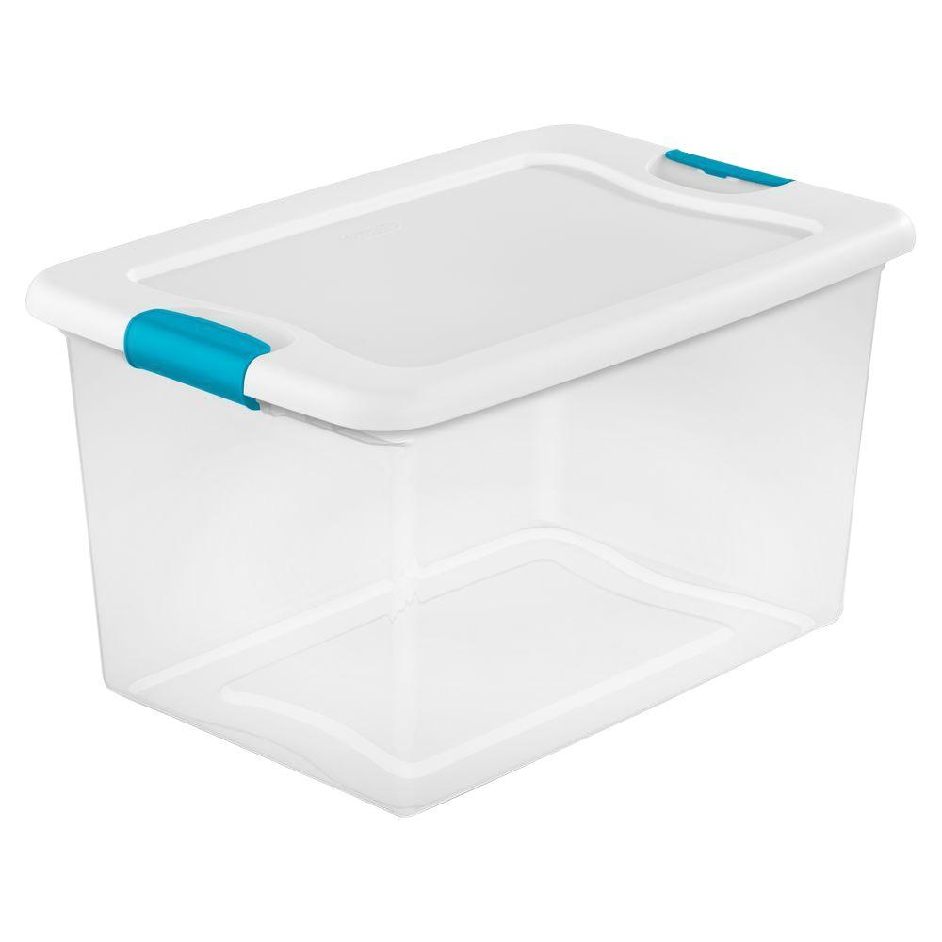
What Is A Container?
Holds Things
Is Portable
Has clear interfaces for access
Can be obtained from a remote location
Notes:
The following metaphors are from this blog post: https://towardsdatascience.com/learn-enough-docker-to-be-useful-b7ba70caeb4b
Container
Like a physical plastic container, a Docker container:
Holds things
Something is either inside the container or outside the container.
Is portable
It can be used on your local machine, your coworker’s machine, or a cloud provider’s servers (e.g. Azure).
Sort of like all that stuff you keep moving with you from home to home.
Has clear interfaces for access
Our physical container has a lid for opening and putting things in and taking things out.
Similarly, a Docker container has several mechanisms for interfacing with the outside world.
It has ports that can be opened for interacting through the browser.
You can configure it to interact with data through the command line.
Can be obtained from a remote location
You can get another empty plastic container from Amazon.com when you need it.
Amazon gets its plastic containers from manufacturers who stamp them out by the thousands from a single mold.
In the case of a Docker container, an offsite registry keeps an image, which is like a mold, for your container.
Then when you need a container you can make one from the image.

Slide 12

What Is A Container?
A container consists of an entire runtime environment (e.g., a tiny Linux OS), an application, plus the following:
Dependencies
Libraries
Other binaries
Configuration files needed to run it

Slide 13
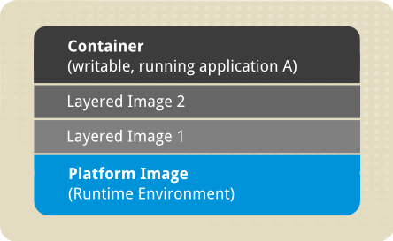
Docker Images And Layers
Dockerfile defines how image includes system libraries, tools, and other files and dependencies
Image starts with a base platform (OS) image
Docker creates read-only intermediate layers based on Dockerfile statements
Container (writable application layer) contains newly written files, modifications to existing files, and newly deleted files
Notes:
Docker Image
A Docker image is a file, comprised of multiple layers, used to execute code in a Docker container.
An image is essentially built from the instructions for a complete and executable version of an application, which relies on the host OS kernel.
When the Docker user runs an image, it becomes one or multiple instances of that container.
Docker images and layers
A Docker image is made up of multiple layers.
A user composes each Docker image to include system libraries, tools, and other files and dependencies for the executable code.
Image developers can reuse static image layers for different projects. Reuse saves time, because a user does not have to create everything in an image.
Most Docker images start with a base image, although a user can build one entirely from scratch, if desired.
Each image has one readable/writable top layer over static layers. Layers are added to the base image to tailor the code to run in a container.
Each layer of a Docker image is viewable under /var/lib/docker/aufs/diff, or via the Docker history command in the command line interface (CLI).
By default, Docker shows all top-layer images, such as the repository, tags and file sizes.
Intermediate layers are cached, which makes top layers easier to view. Docker utilizes storage drivers to manage contents of image layers.
When a new container is created from an image, a writable layer is also created. This layer is called the container layer, and it hosts all changes made to the running container. This layer can store newly written files, modifications to existing files and newly deleted files.
The writable layer allows customization of the container. Changes made to the writable layer are saved on that layer. Multiple containers can share the same underlying base image and have their own data state thanks to the writable layer.

Slide 14
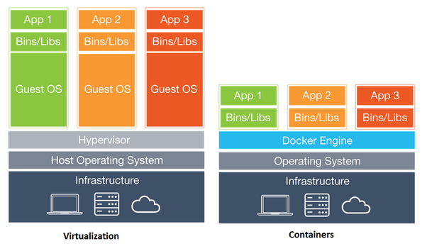
What's The Difference Between Containers And Virtualization?
Notes:
Virtualization (i.e. Virtual Machines)
With virtualization technology, the package that can be passed around is a virtual machine, and it includes an entire operating system as well as the application.
A physical server running three virtual machines would have a hypervisor and three separate operating systems running on top of it.
Containers
By contrast a server running three containerized applications with Docker runs a single operating system, and each container shares the operating system kernel with the other containers.
Shared parts of the operating system are read only, while each container has its own mount (i.e., a way to access the container) for writing.
That means the containers are much more lightweight and use far fewer resources than virtual machines.

Slide 15
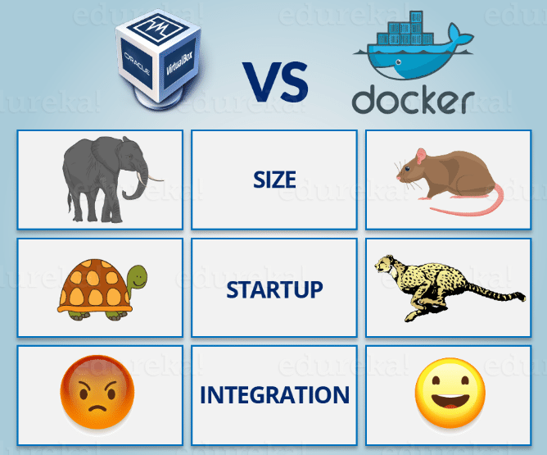
What Other Benefits Do Containers Offer?
Notes:
Size
A container may be only tens of megabytes in size, whereas a virtual machine with its own entire operating system may be several gigabytes in size.
Because of this, a single server can host far more containers than virtual machines.
Startup Speed
Another major benefit is that virtual machines may take several minutes to boot up their operating systems and begin running the applications they host, while containerized applications can be started almost instantly.
That means containers can be instantiated in a "just in time" fashion when they are needed and can disappear when they are no longer required, freeing up resources on their hosts.
Integration (Modularity)
A third benefit is that containerization allows for greater modularity.
Rather than run an entire complex application inside a single container, the application can be split in to modules.
This is the so-called microservices approach.
Applications built in this way are easier to manage because each module is relatively simple, and changes can be made to modules without having to rebuild the entire application.

Slide 16
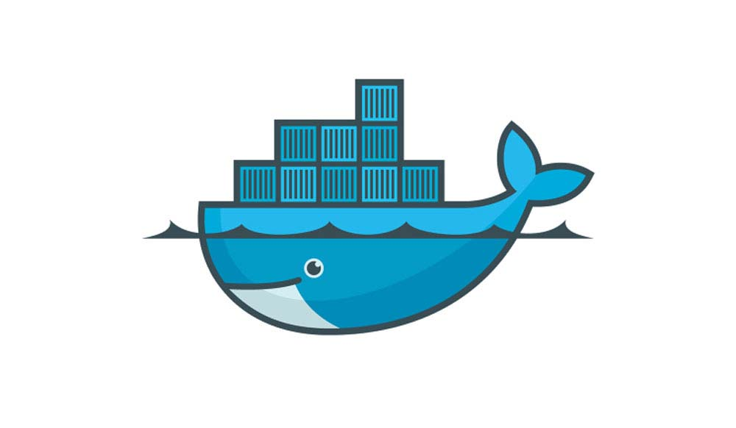
Docker For Windows
What Is Docker?
Overview Of Docker Setup
Developer Firewall Proxy Mitigation
How to Dockerize an ASP.NET Core Web Application
How To Create A Container
How To Run A Container
Notes:
What Is Docker?
Docker is a tool designed to make it easier to create, deploy, and run applications by using containers.
Containers allow a developer to package up an application with all of the parts it needs, such as libraries and other dependencies, and ship it all out as one package.
DEMO
Show location if Docker installation instructions:
Enable system support for virtualization at BIOS level
Enable Windows 10 Hyper-V using PowerShell
Install Docker for WIndows
Show location of Docker training materials
Create a simple web app
Add a Dockerfile to the web app project
Create and edit a release version of the Dockerfile
Create a Kubernetes folder in the web app
Add az-login.ps1 to the Kubernetes folder
Show how to configure firewall
For more information, see the following:
https://towardsdatascience.com/learn-enough-docker-to-be-useful-b7ba70caeb4b
https://towardsdatascience.com/learn-enough-docker-to-be-useful-1c40ea269fa8

Slide 17

How To Build And Run/Debug Code In Local Docker Containers
Demos

Slide 18


Slide 19
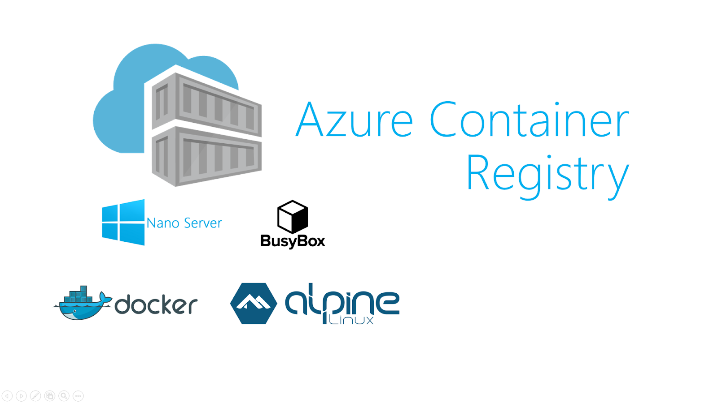
Azure Container Registry
What Is A Container Registry?
Overview Of Azure Container Registry
How To Build An Image For A Container Registry
How To Push An Image To A Container Registry
Notes:
What is a Container Registry?
Container registries are useful A container registry is a repository for storing container images. A container image consists of many files, which encapsulate an application. After a host puts an image into a registry, other hosts can download it from the registry server. This allows the same application to be shipped from a host to another.
Who should use a container registry Developers, testers and CI/CD systems need to use a registry to store images created during the application development process. Container images placed in the registry can be used in various phases of the development.
How organizations are using a container registry To begin with, users usually use public registry service such as Docker Hub because it is simple and easy to use. However, when they are getting serious in using containers, organizations often wonder whether to continue to use a public registry service or not. For security and efficiency reasons, a private registry should be set up within their organization.
Container registries are secure and efficient For security and efficiency purposes, many choose to set up their own instance of private registry within their organizations. Once they do that, the next question is how they can protect their images.
Protecting images in container registries By assigning role-based access control (RBAC) to the images using a user identity already established in their organization, such as LDAP and Active Directory. For additional security layers, images should be digitally signed to ensure their authenticity from trusted authors. Furthermore, images should be scanned for vulnerabilities and patches can be applied accordingly. By using a SaaS such as Twistlock, users can achieve goals to secure their images.
Cloud-native applications and container registries Cloud-native applications are often built using container technology. Therefore, people running cloud-native applications should use a registry during their application lifecycle.
What Is Azure Container Registry (ACR)?
Azure Container Registry is a managed Docker registry service based on the open-source Docker Registry 2.0.
Create and maintain Azure container registries to store and manage your private Docker container images.
Use container registries in Azure with your existing container development and deployment pipelines.
Use Azure Container Registry Build (ACR Build) to build container images in Azure.
Build on demand, or fully automate builds with source code commit and base image update build triggers.

Slide 20
How To Build And Push Local Images To An Azure Container Registry
Demos

Slide 21
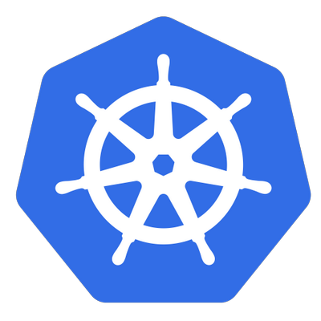
Kubernetes
What Is Kubernetes?
What Are Its features?
Notes:
The following information is from https://kubernetes.io/
What Is Kubernetes?
Kubernetes (k8s) is an open-source system for automating deployment, scaling, and management of containerized applications.
It groups containers that make up an application into logical units for easy management and discovery.
Kubernetes builds upon 15 years of experience of running production workloads at Google, combined with best-of-breed ideas and practices from the community.
Planet Scale
Designed on the same principles that allows Google to run billions of containers a week, Kubernetes can scale without increasing your ops team.
Never Outgrow
Whether testing locally or running a global enterprise, Kubernetes flexibility grows with you to deliver your applications consistently and easily no matter how complex your need is.
Run Anywhere
Kubernetes is open source giving you the freedom to take advantage of on-premises, hybrid, or public cloud infrastructure, letting you effortlessly move workloads to where it matters to you.
*** Kubernetes Features ***
Service discovery and load balancing
No need to modify your application to use an unfamiliar service discovery mechanism. Kubernetes gives containers their own IP addresses and a single DNS name for a set of containers, and can load-balance across them.
Automatic binpacking
Automatically places containers based on their resource requirements and other constraints, while not sacrificing availability. Mix critical and best-effort workloads in order to drive up utilization and save even more resources.
Storage orchestration
Automatically mount the storage system of your choice, whether from local storage, a public cloud provider such as GCP or AWS, or a network storage system such as NFS, iSCSI, Gluster, Ceph, Cinder, or Flocker.
Self-healing
Restarts containers that fail, replaces and reschedules containers when nodes die, kills containers that don’t respond to your user-defined health check, and doesn’t advertise them to clients until they are ready to serve.
Automated rollouts and rollbacks
Kubernetes progressively rolls out changes to your application or its configuration, while monitoring application health to ensure it doesn’t kill all your instances at the same time. If something goes wrong, Kubernetes will rollback the change for you. Take advantage of a growing ecosystem of deployment solutions.
Secret and configuration management
Deploy and update secrets and application configuration without rebuilding your image and without exposing secrets in your stack configuration.
Batch execution
In addition to services, Kubernetes can manage your batch and CI workloads, replacing containers that fail, if desired.
Horizontal scaling
Scale your application up and down with a simple command, with a UI, or automatically based on CPU usage.

Slide 22
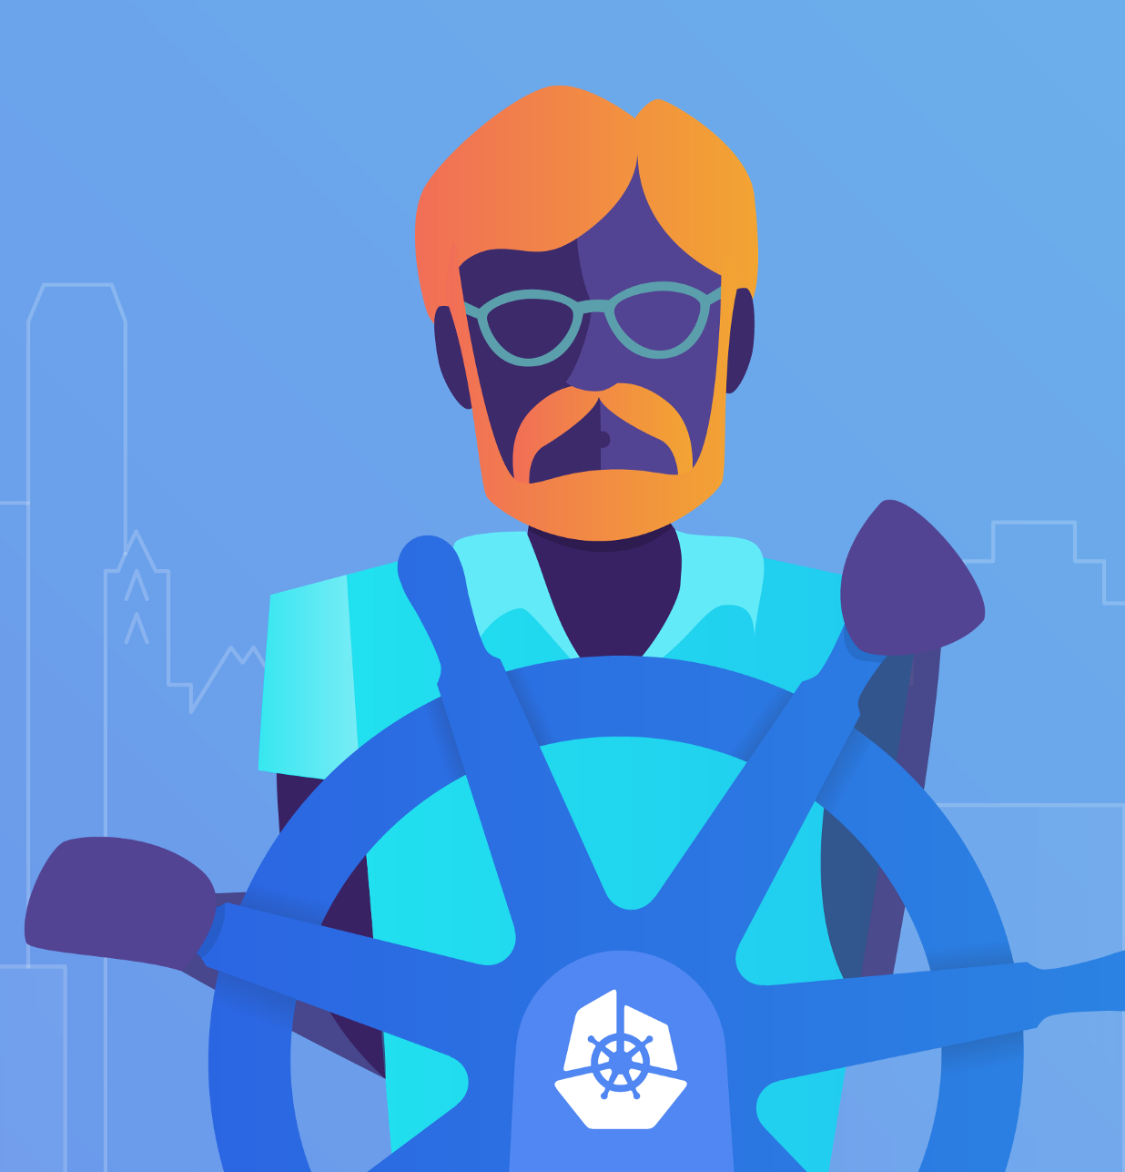
Origin Of Kubernetes
In ancient Greek, "kubernan" means to steer Whereas "kubernetes" means helmsman

Slide 23
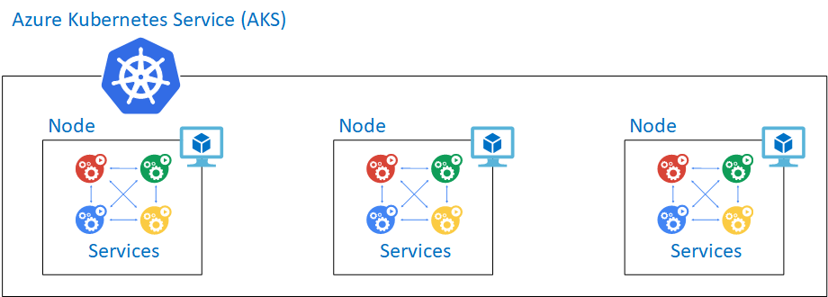
Barebones AKS
Azure Kubernetes Service With Basic Networking
1 – 3 Nodes (Virtual Machines)

Slide 24
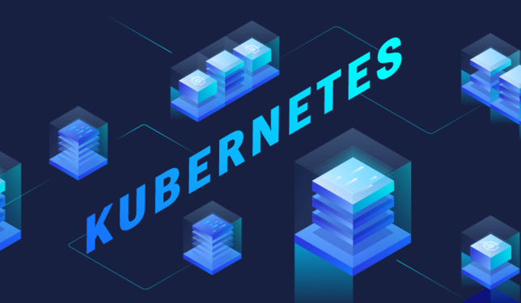
Kubernetes Objects
What Is A Pod?
What Is A Service?
What Is A Namespace?
What Is A ReplicaSet?
What Is A Deployment?
What Is A Node?
What Is An Ingress?
Notes:
The following information is from https://kubernetes.io/

Slide 25
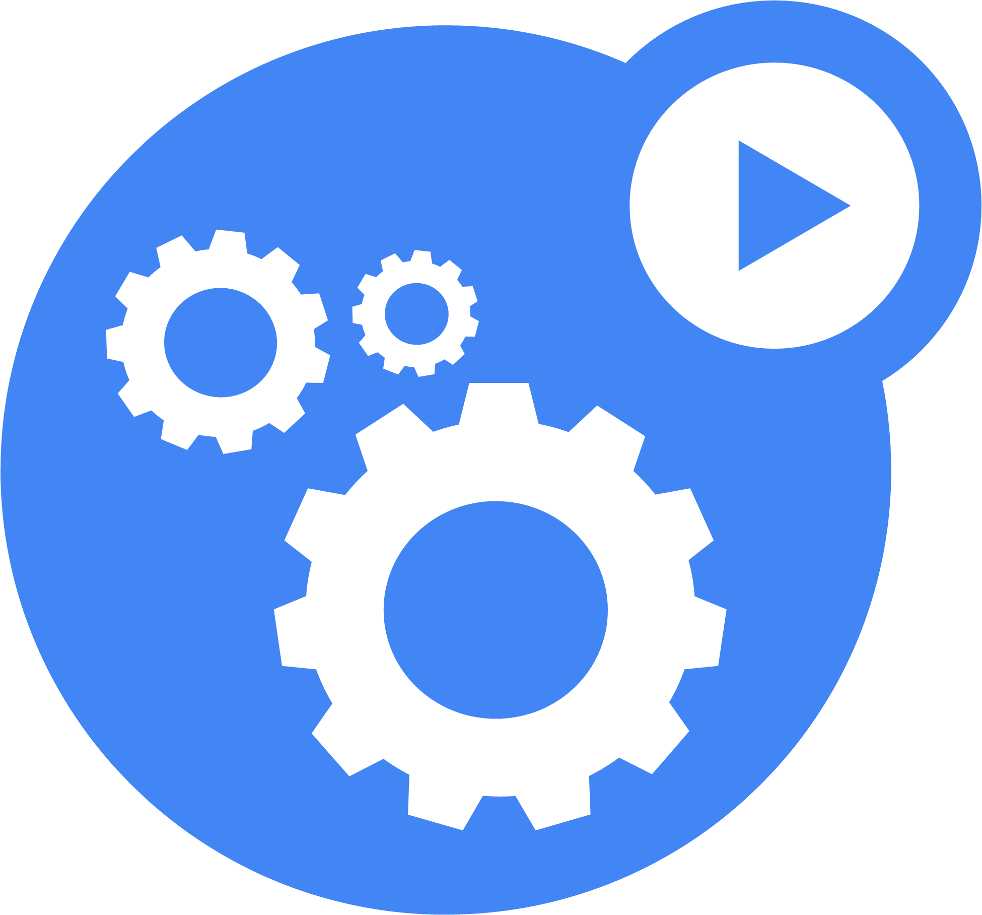
What Is A Pod?
A Pod is the basic building block of Kubernetes–the smallest and simplest unit in the Kubernetes object model that you create or deploy.
A Pod represents a running process (app) on your cluster.
Notes:
What Is A Pod?
A Pod is the basic building block of Kubernetes–the smallest and simplest unit in the Kubernetes object model that you create or deploy. A Pod represents a running process on your cluster.
A Pod encapsulates an application container (or, in some cases, multiple containers), storage resources, a unique network IP, and options that govern how the container(s) should run.
A Pod represents a unit of deployment: a single instance of an application in Kubernetes, which might consist of either a single container or a small number of containers that are tightly coupled and that share resources.
Docker is the most common container runtime used in a Kubernetes Pod, but Pods support other container runtimes as well.
Pods in a Kubernetes cluster can be used in two main ways:
Pods that run a single container. The “one-container-per-Pod” model is the most common Kubernetes use case; in this case, you can think of a Pod as a wrapper around a single container, and Kubernetes manages the Pods rather than the containers directly.
Pods that run multiple containers that need to work together. A Pod might encapsulate an application composed of multiple co-located containers that are tightly coupled and need to share resources. These co-located containers might form a single cohesive unit of service–one container serving files from a shared volume to the public, while a separate “sidecar” container refreshes or updates those files. The Pod wraps these containers and storage resources together as a single manageable entity.
Pods and Controllers
A Controller can create and manage multiple Pods for you, handling replication and rollout and providing self-healing capabilities at cluster scope. For example, if a Node fails, the Controller might automatically replace the Pod by scheduling an identical replacement on a different Node.

Slide 26
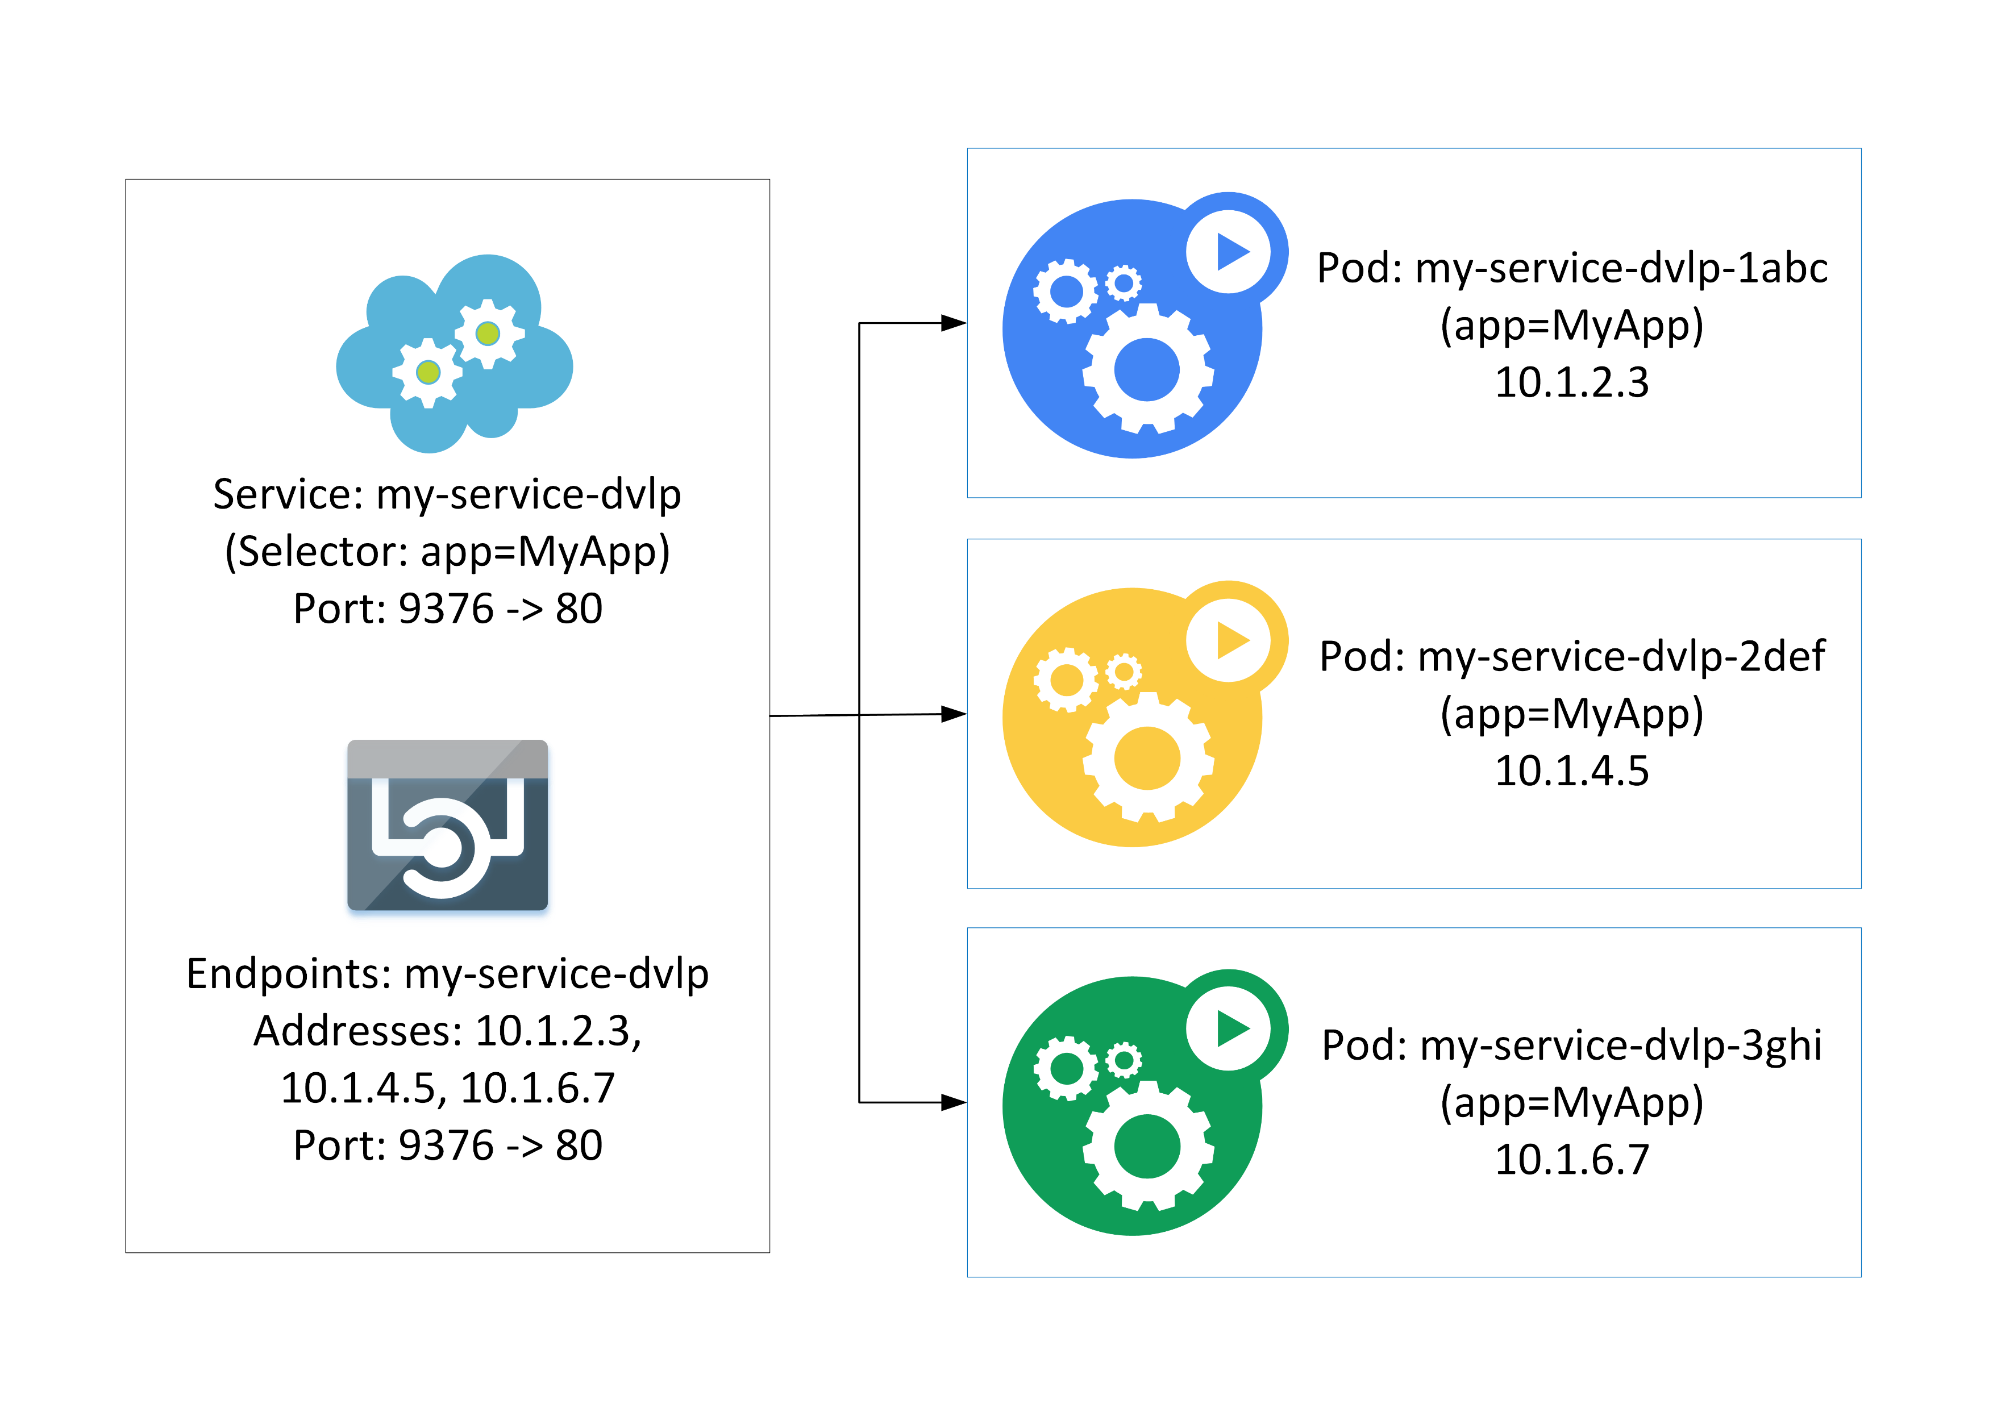
What Is A Service?
A service is an abstraction which defines a logical set of pods and a policy by which to access them - sometimes called a micro-service.
Notes:
What Is A Service?
A Kubernetes Service is an abstraction which defines a logical set of Pods and a policy by which to access them - sometimes called a micro-service.
The set of Pods targeted by a Service is (usually) determined by a Label selector.
Why Problem Do Services Solve?
Kubernetes Pods are mortal. They are born and when they die, they are not resurrected.
ReplicaSets in particular create and destroy Pods dynamically (e.g. when scaling out or in).
While each Pod gets its own IP address, even those IP addresses cannot be relied upon to be stable over time.
This leads to a problem: if some set of Pods (let’s call them backends) provides functionality to other Pods (let’s call them frontends) inside the Kubernetes cluster, how do those frontends find out and keep track of which backends are in that set?
As an example, consider an image-processing backend which is running with 3 replicas. Those replicas are fungible - frontends do not care which backend they use. While the actual Pods that compose the backend set may change, the frontend clients should not need to be aware of that or keep track of the list of backends themselves. The Service abstraction enables this decoupling.
For Kubernetes-native applications, Kubernetes offers a simple Endpoints API that is updated whenever the set of Pods in a Service changes.
For non-native applications, Kubernetes offers a virtual-IP-based bridge to Services which redirects to the backend Pods.

Slide 27
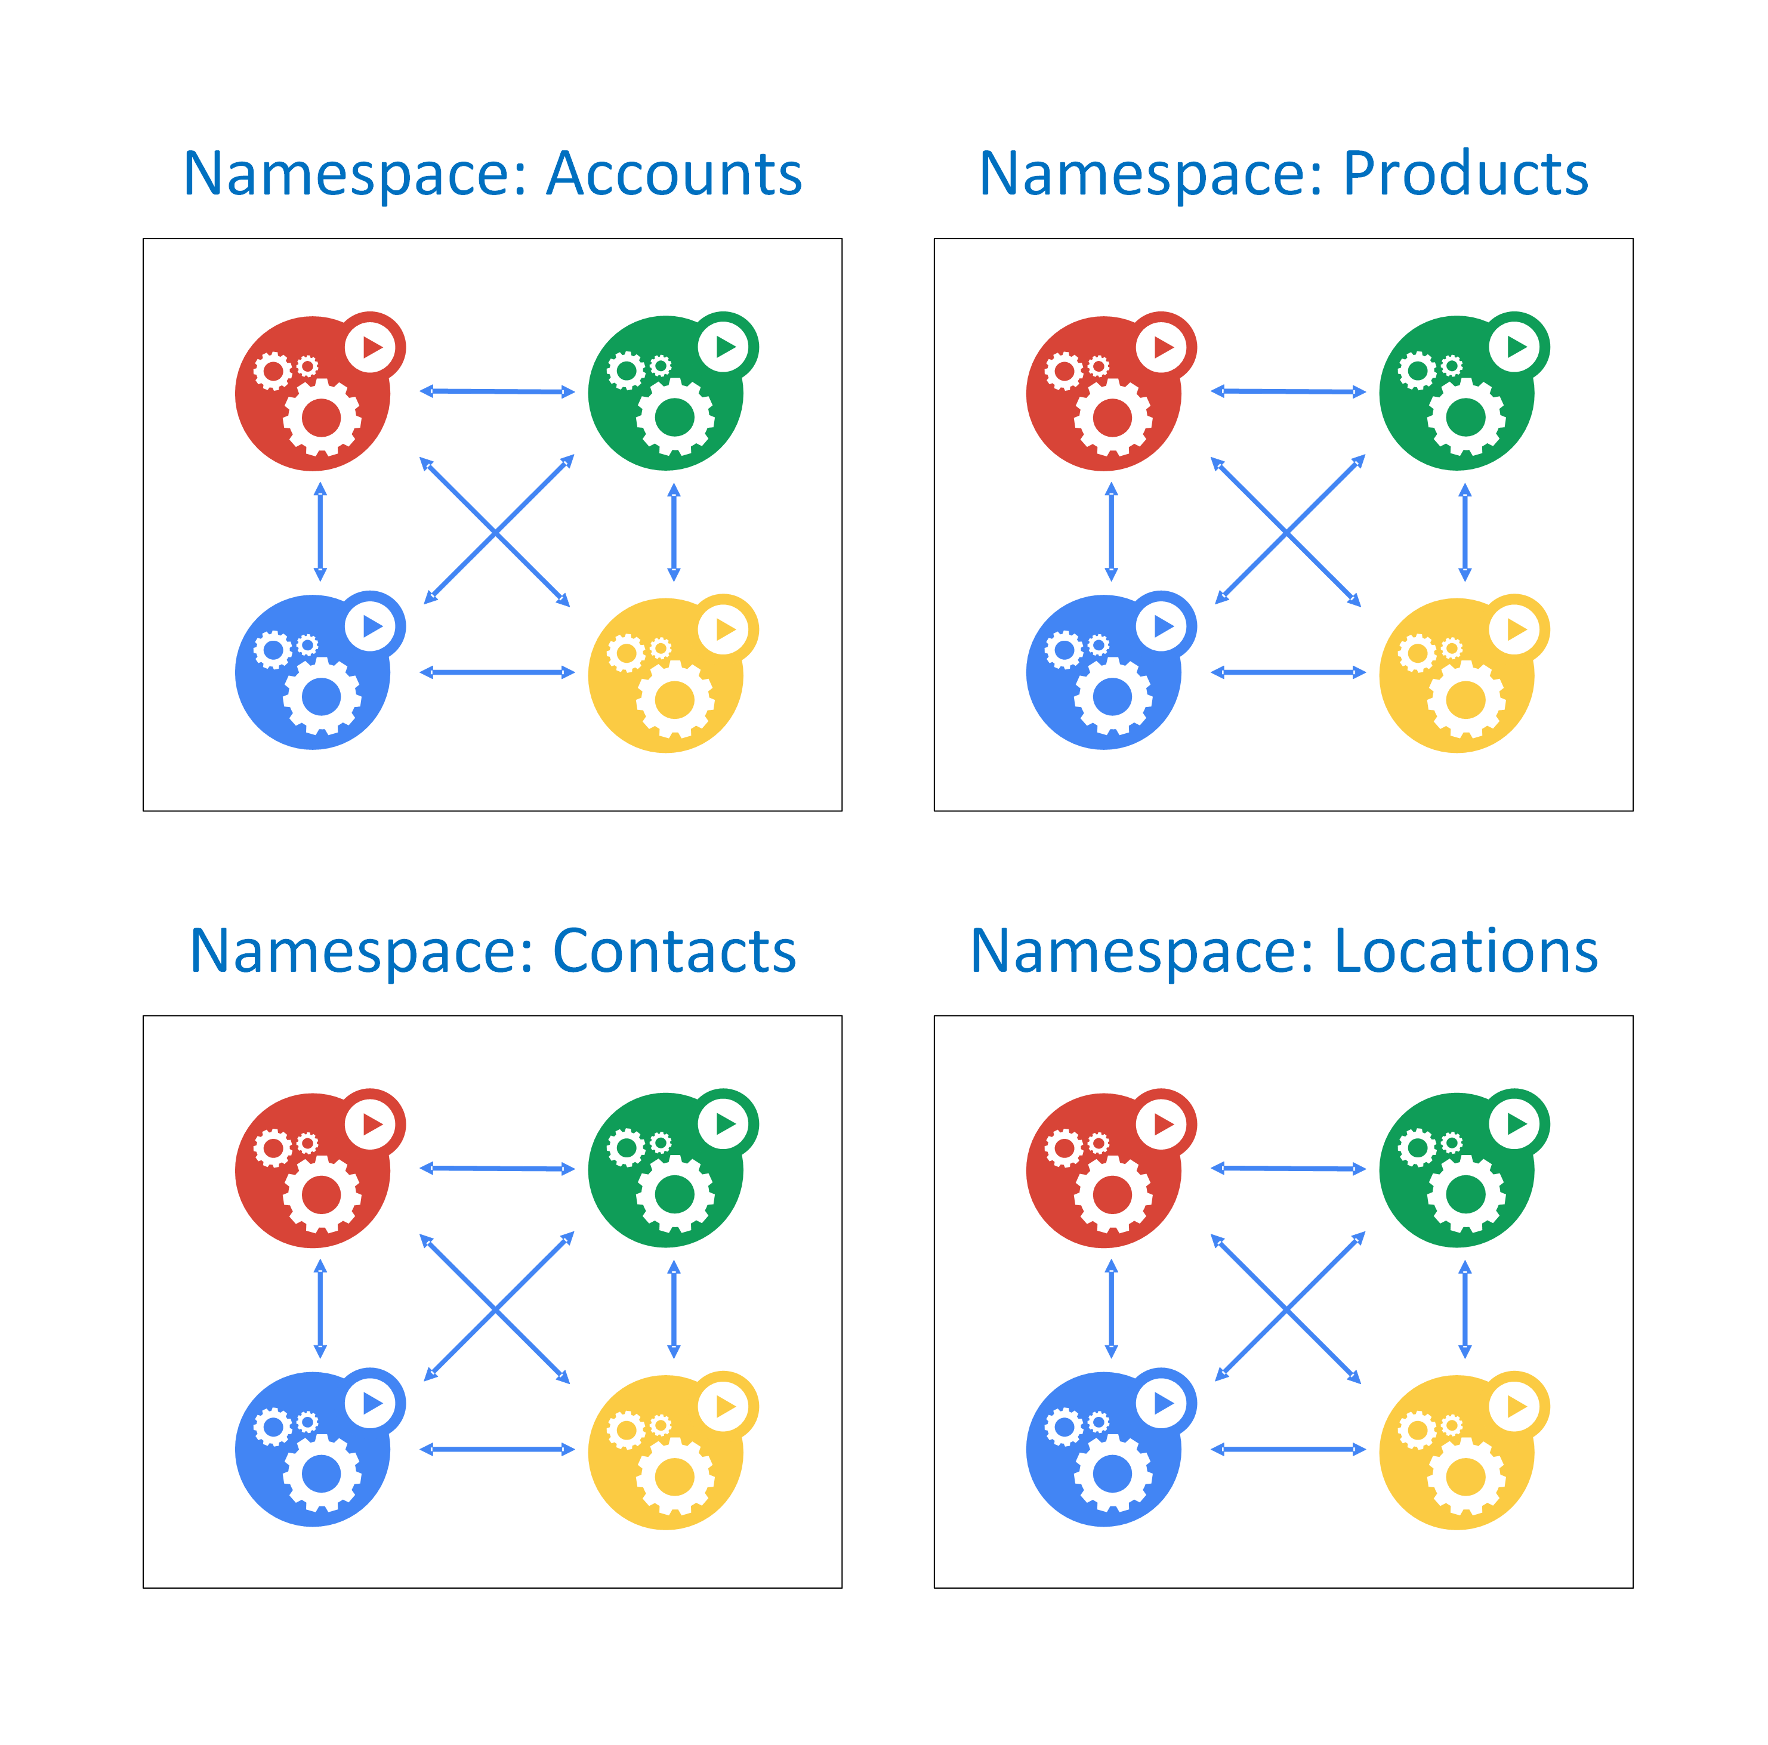
What Is A Namespace?
A namespace provides a way to support multiple virtual clusters backed by the same physical cluster.
They are a way to divide cluster resources between multiple users.
Notes:
What Is A Namespace?
Kubernetes supports multiple virtual clusters backed by the same physical cluster. These virtual clusters are called namespaces.
Namespaces are intended for use in environments with many users spread across multiple teams, or projects. For clusters with a few to tens of users, you should not need to create or think about namespaces at all. Start using namespaces when you need the features they provide.
Namespaces provide a scope for names. Names of resources need to be unique within a namespace, but not across namespaces.
Namespaces are a way to divide cluster resources between multiple users (via resource quota).
In future versions of Kubernetes, objects in the same namespace will have the same access control policies by default.
It is not necessary to use multiple namespaces just to separate slightly different resources, such as different versions of the same software: use labels to distinguish resources within the same namespace.

Slide 28
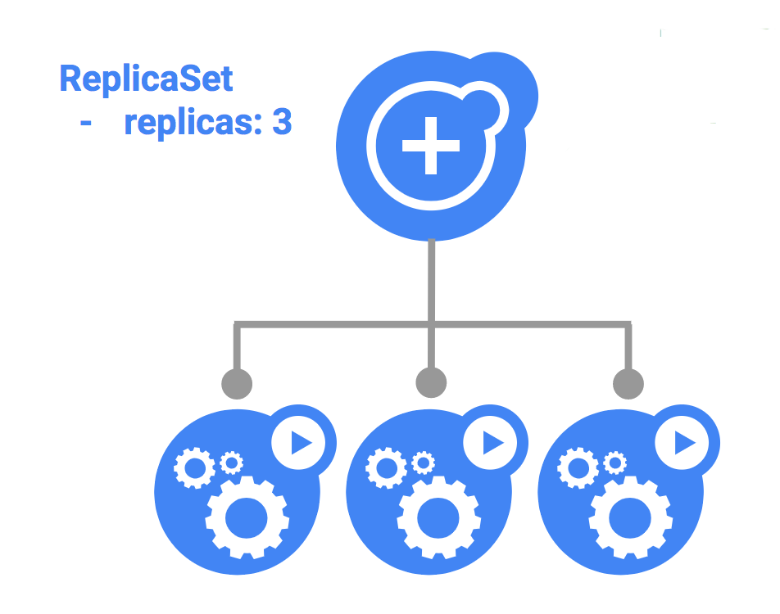
What Is A ReplicaSet?
A ReplicaSet’s purpose is to maintain a stable set of replica Pods running at any given time.
As such, it is often used to guarantee the availability of a specified number of identical Pods.
Notes:
What Is A ReplicaSet?
A ReplicaSet’s purpose is to maintain a stable set of replica Pods running at any given time.
As such, it is often used to guarantee the availability of a specified number of identical Pods.
A ReplicaSet is defined with fields, including a selector that specifies how to identify Pods it can acquire, a number of replicas indicating how many Pods it should be maintaining, and a pod template specifying the data of new Pods it should create to meet the number of replicas criteria.
A ReplicaSet then fulfills its purpose by creating and deleting Pods as needed to reach the desired number.
When a ReplicaSet needs to create new Pods, it uses its Pod template.
When to use a ReplicaSet
A ReplicaSet ensures that a specified number of pod replicas are running at any given time.
However, a Deployment is a higher-level concept that manages ReplicaSets and provides declarative updates to Pods along with a lot of other useful features. T
herefore, we recommend using Deployments instead of directly using ReplicaSets, unless you require custom update orchestration or don’t require updates at all.
This actually means that you may never need to manipulate ReplicaSet objects: use a Deployment instead, and define your application in the spec section.

Slide 29
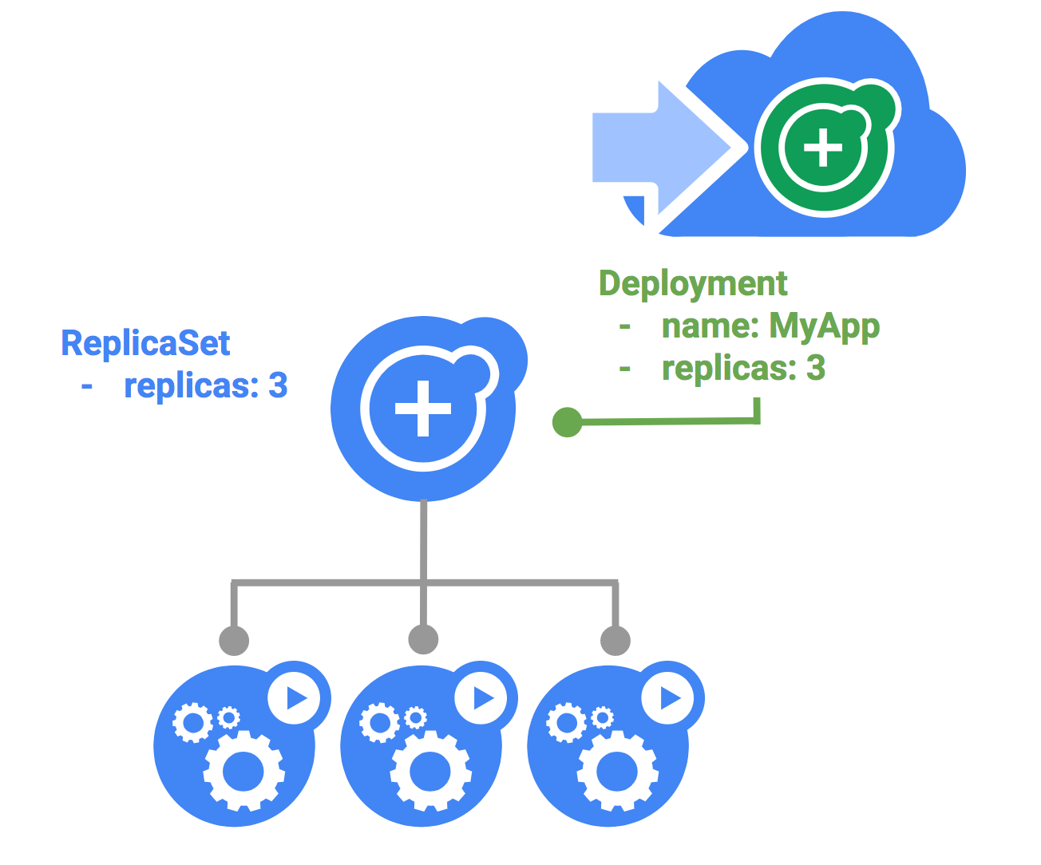
What Is A Deployment?
A Deployment controller provides declarative updates for Pods and ReplicaSets.
You describe a desired state in a Deployment object, and the Deployment controller manages the changes for you.
Notes:
What Is A Deployment?
A Deployment controller provides declarative updates for Pods and ReplicaSets.
You describe a desired state in a Deployment object, and the Deployment controller changes the actual state to the desired state at a controlled rate.
You can define Deployments to create new ReplicaSets, or to remove existing Deployments and adopt all their resources with new Deployments.
Use Cases
The following are typical use cases for Deployments:
Create a Deployment to rollout a ReplicaSet. The ReplicaSet creates Pods in the background. Check the status of the rollout to see if it succeeds or not.
Declare the new state of the Pods by updating the PodTemplateSpec of the Deployment. A new ReplicaSet is created and the Deployment manages moving the Pods from the old ReplicaSet to the new one at a controlled rate. Each new ReplicaSet updates the revision of the Deployment.
Rollback to an earlier Deployment revision if the current state of the Deployment is not stable. Each rollback updates the revision of the Deployment.
Scale up the Deployment to facilitate more load.
Pause the Deployment to apply multiple fixes to its PodTemplateSpec and then resume it to start a new rollout.
Use the status of the Deployment as an indicator that a rollout has stuck.
Clean up older ReplicaSets that you don’t need anymore.

Slide 30
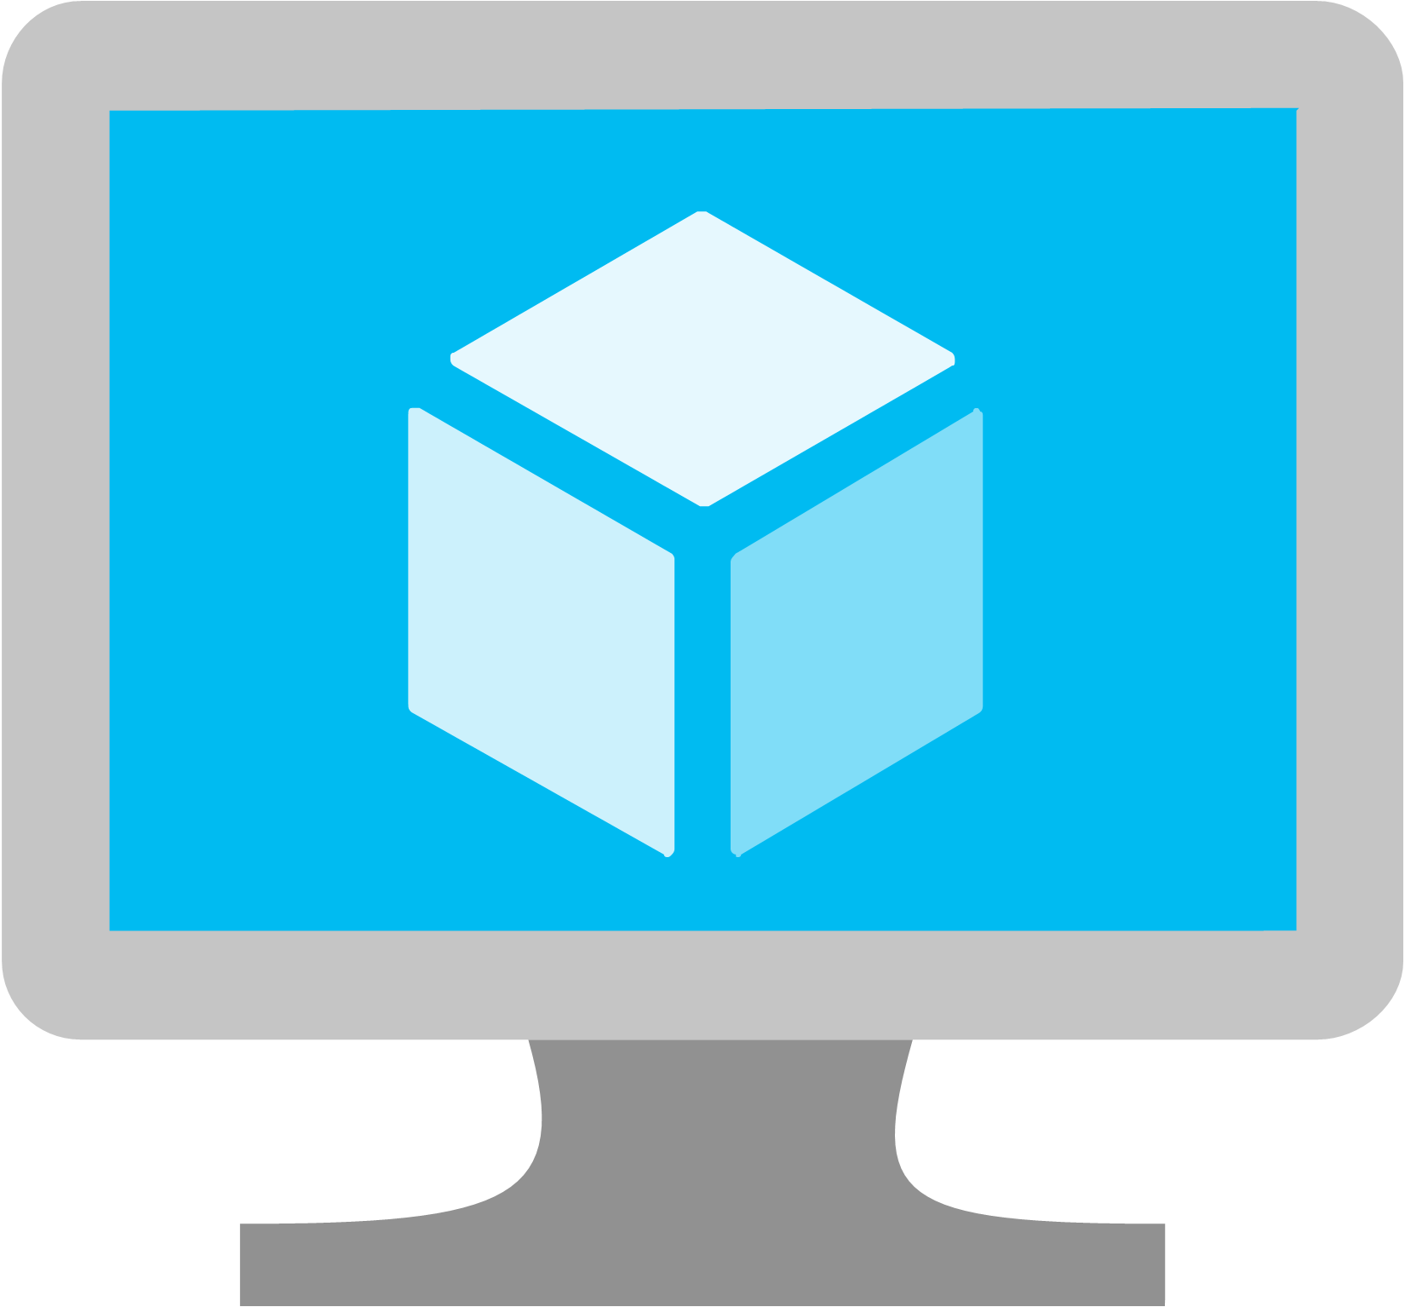
What Is A Node?
A node is a worker machine in Kubernetes, previously known as a minion.
A node may be a VM or physical machine, depending on the cluster.
Notes:
What Is A Node?
A node is a worker machine in Kubernetes, previously known as a minion.
A node may be a VM or physical machine, depending on the cluster.
Each node contains the services necessary to run pods and is managed by the master components.
The services on a node include the container runtime, kubelet and kube-proxy.

Slide 31
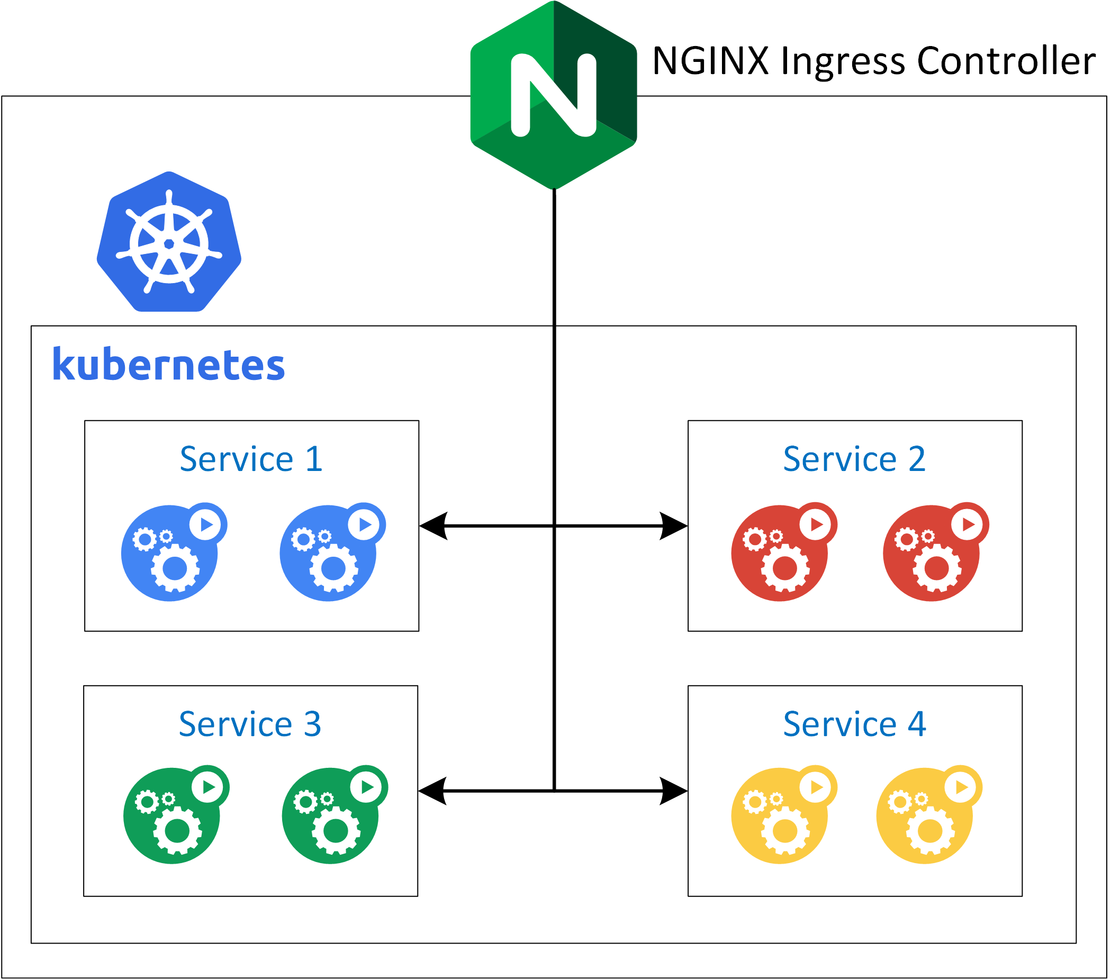
What Is Ingress?
An API object that manages external access to the services in a cluster, typically HTTP.
Ingress can provide load balancing, SSL termination and name-based virtual hosting.
Notes:
What Is Ingress?
An API object that manages external access to the services in a cluster, typically HTTP.
Ingress can provide load balancing, SSL termination and name-based virtual hosting.
What Is An Ingress Controller?
An ingress controller exposes HTTP and HTTPS routes from outside the cluster to services within the cluster.
Traffic routing is controlled by rules defined on the Ingress resource.
internet
|
[ Ingress ]
--|-----|--
[ Services ]
An Ingress can be configured to give services externally-reachable URLs, load balance traffic, terminate SSL, and offer name based virtual hosting.
An Ingress controller is responsible for fulfilling the Ingress, usually with a load balancer, though it may also configure your edge router or additional frontends to help handle the traffic.
An Ingress does not expose arbitrary ports or protocols.

Slide 32
How To Deploy Local Containers To A Local Kubernetes Cluster
Demos

Slide 33


Slide 34
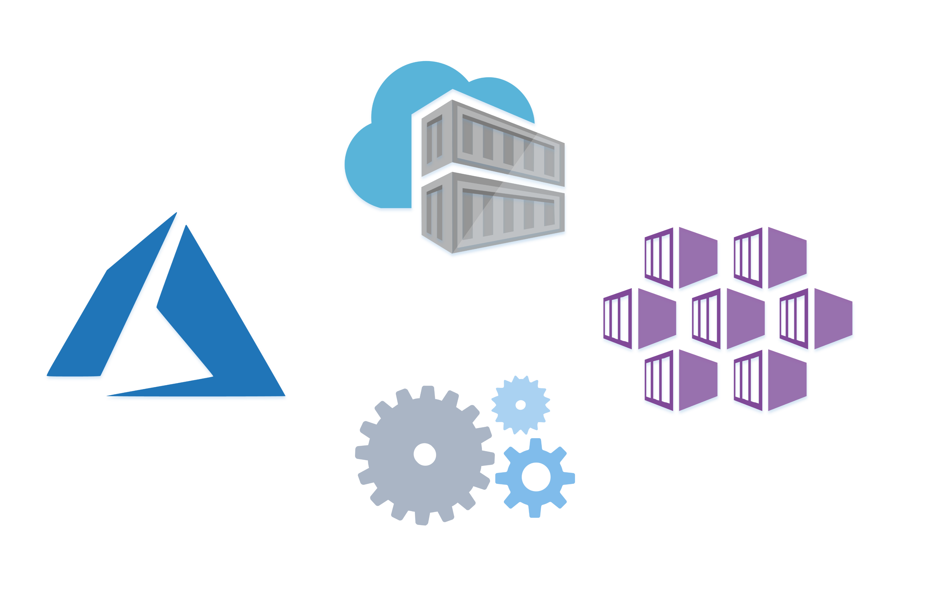
Azure Kubernetes Service
How Do Containers Get Deployed?
How Does Autoscaling Work?
What Happens When A Container Dies?
How Do I Manage An Application In A Container?
Where Can I See Application Performance Data?
Where Can I See Application Security Access Logs?
Notes:
What Is Azure Kubernetes Service (AKS)?
Azure Kubernetes Service (AKS) makes it simple to deploy a managed Kubernetes cluster in Azure.
AKS reduces the complexity and operational overhead of managing Kubernetes by offloading much of that responsibility to Azure.
As a hosted Kubernetes service, Azure handles critical tasks like health monitoring and maintenance for you.
How Virtual Networks and Ingress Make AKS a Secure Environment
An AKS cluster can be deployed into an existing virtual network. In this configuration, every pod in the cluster is assigned an IP address in the virtual network, and can directly communicate with other pods in the cluster, and other nodes in the virtual network.
Pods can also connect to other services in a peered virtual network, and to on-premises networks over ExpressRoute or site-to-site (S2S) VPN connections.

Slide 35
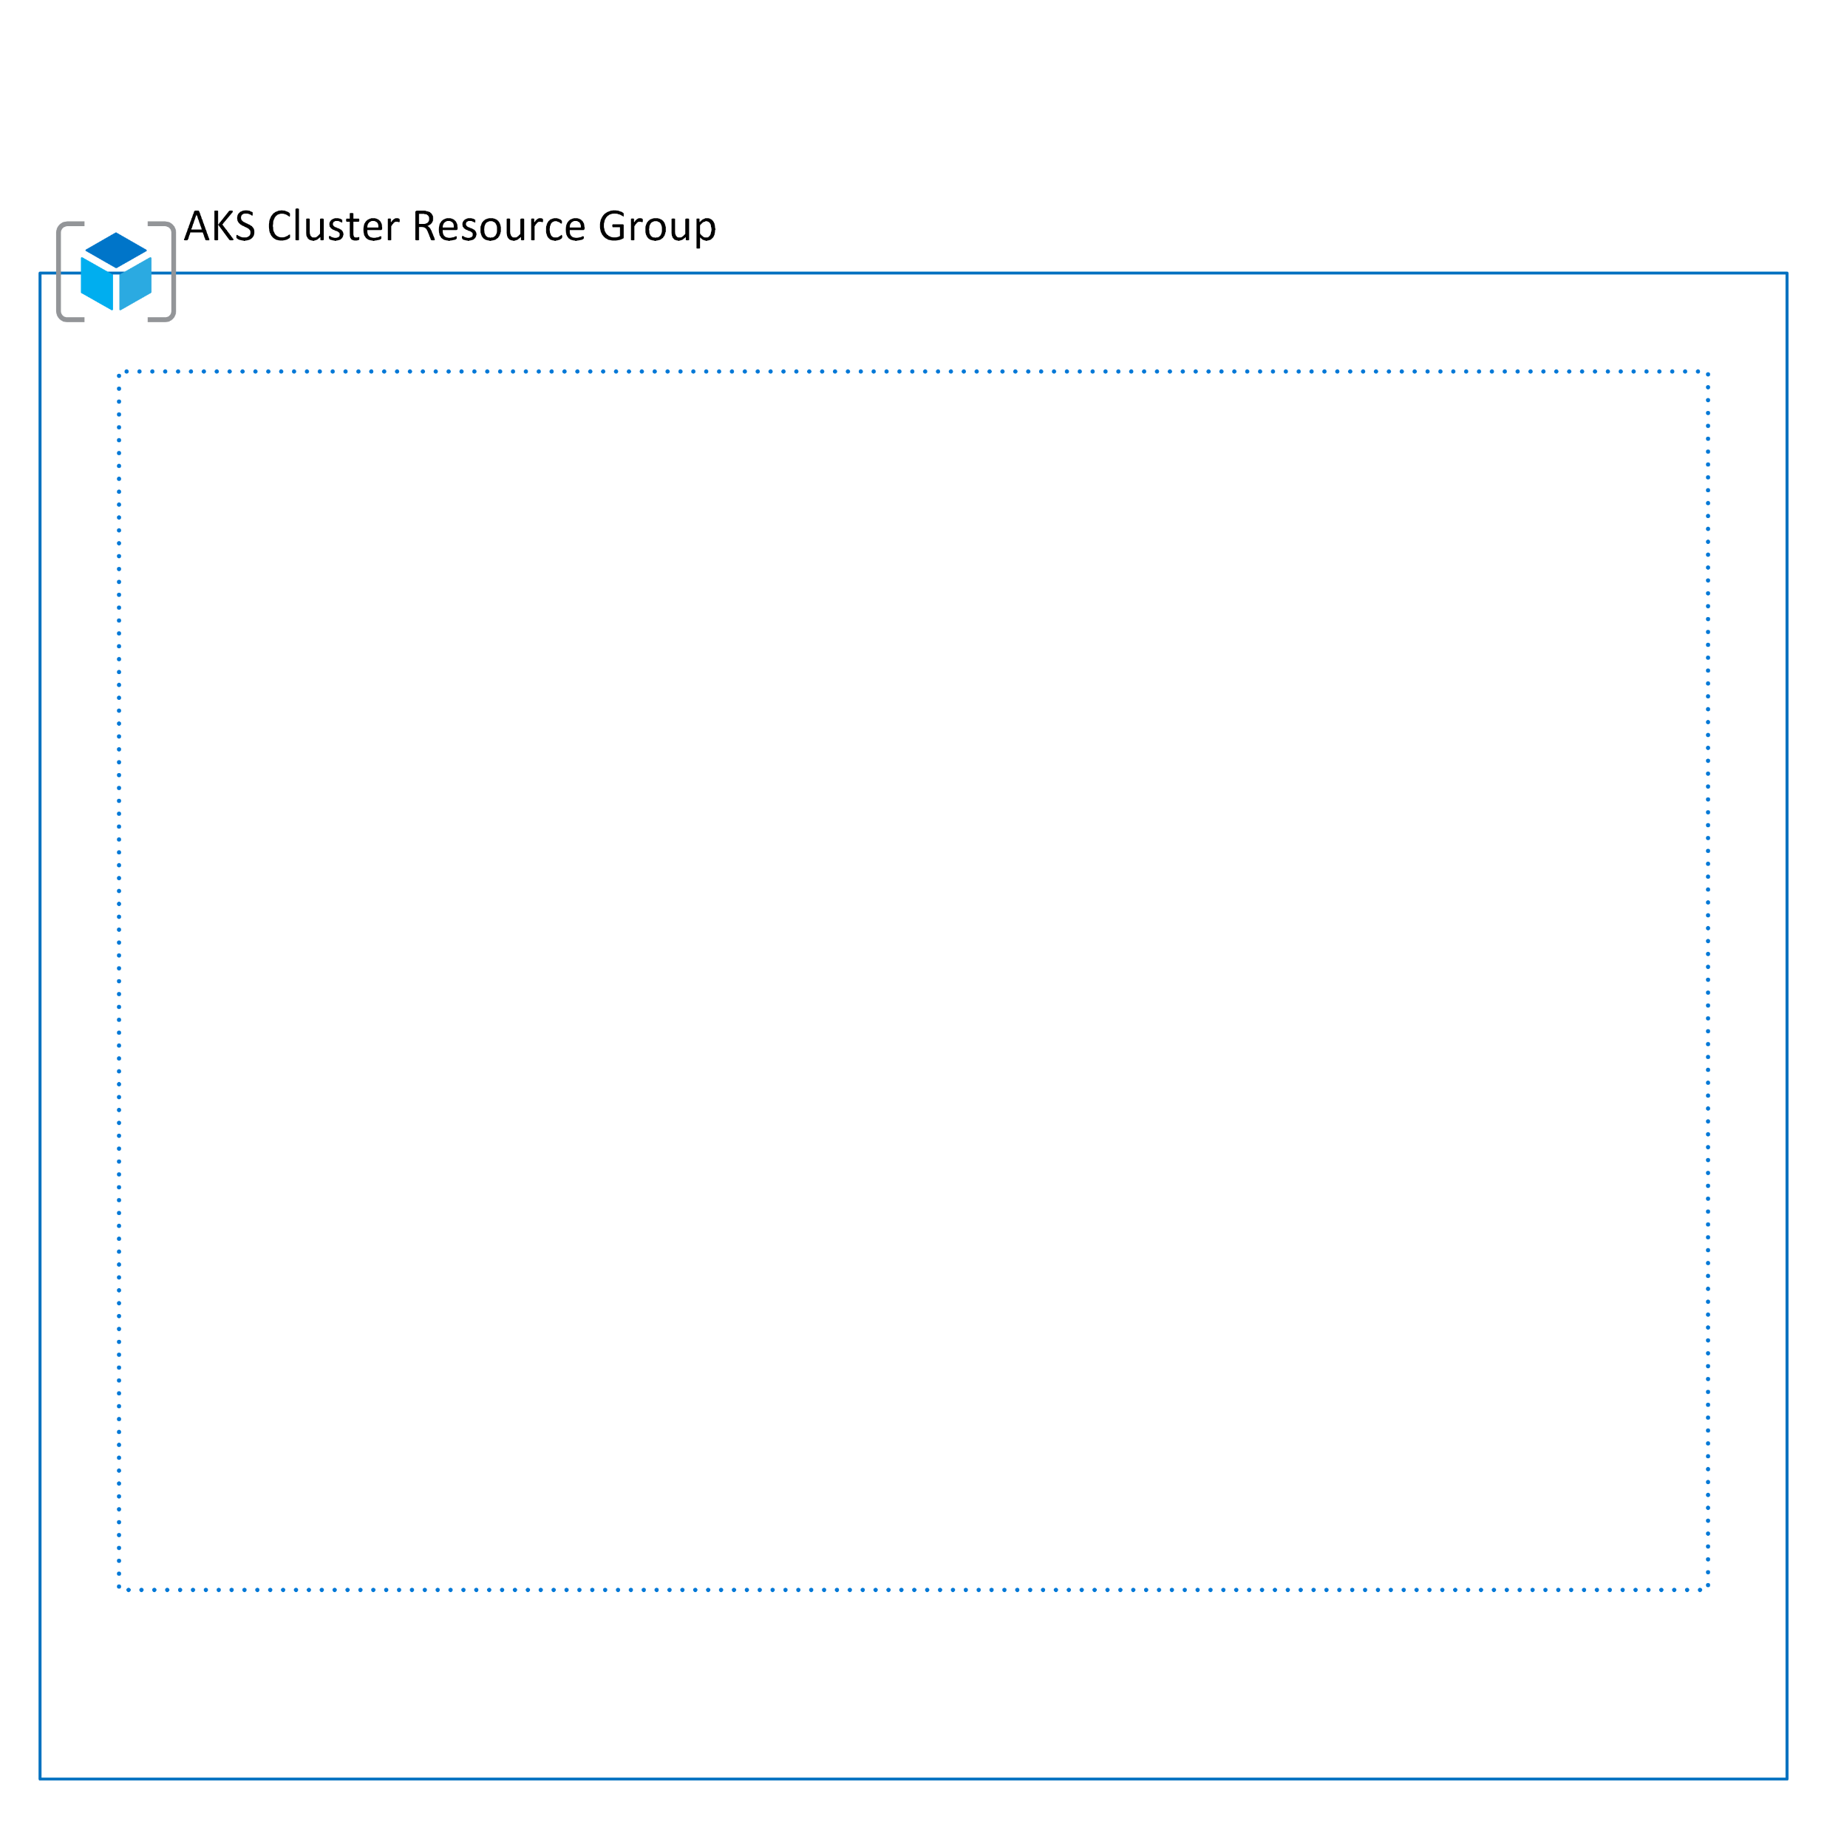
Azure Resource Group
Notes:
Azure provides four levels of management: management groups, subscriptions, resource groups, and resources.
Management Groups
These are containers that help you manage access, policy, and compliance across multiple subscriptions.
All subscriptions within a management group automatically inherit the conditions applied to the management group.
Subscriptions
A subscription groups together user accounts and the resources that have been created by those user accounts.
For each subscription, there are limits or quotas on the amount of resources you can create and use.
Organizations can use subscriptions to manage costs and the resources that are created by users, teams, or projects.
Resource groups
A resource group is a logical container into which Azure resources like web apps, databases, and storage accounts are deployed and managed.
Resources:
Resources are instances of services that you create like virtual networking infrastructure, Azure Kubernetes Service, Application Gateway, or SQL databases.

Slide 36
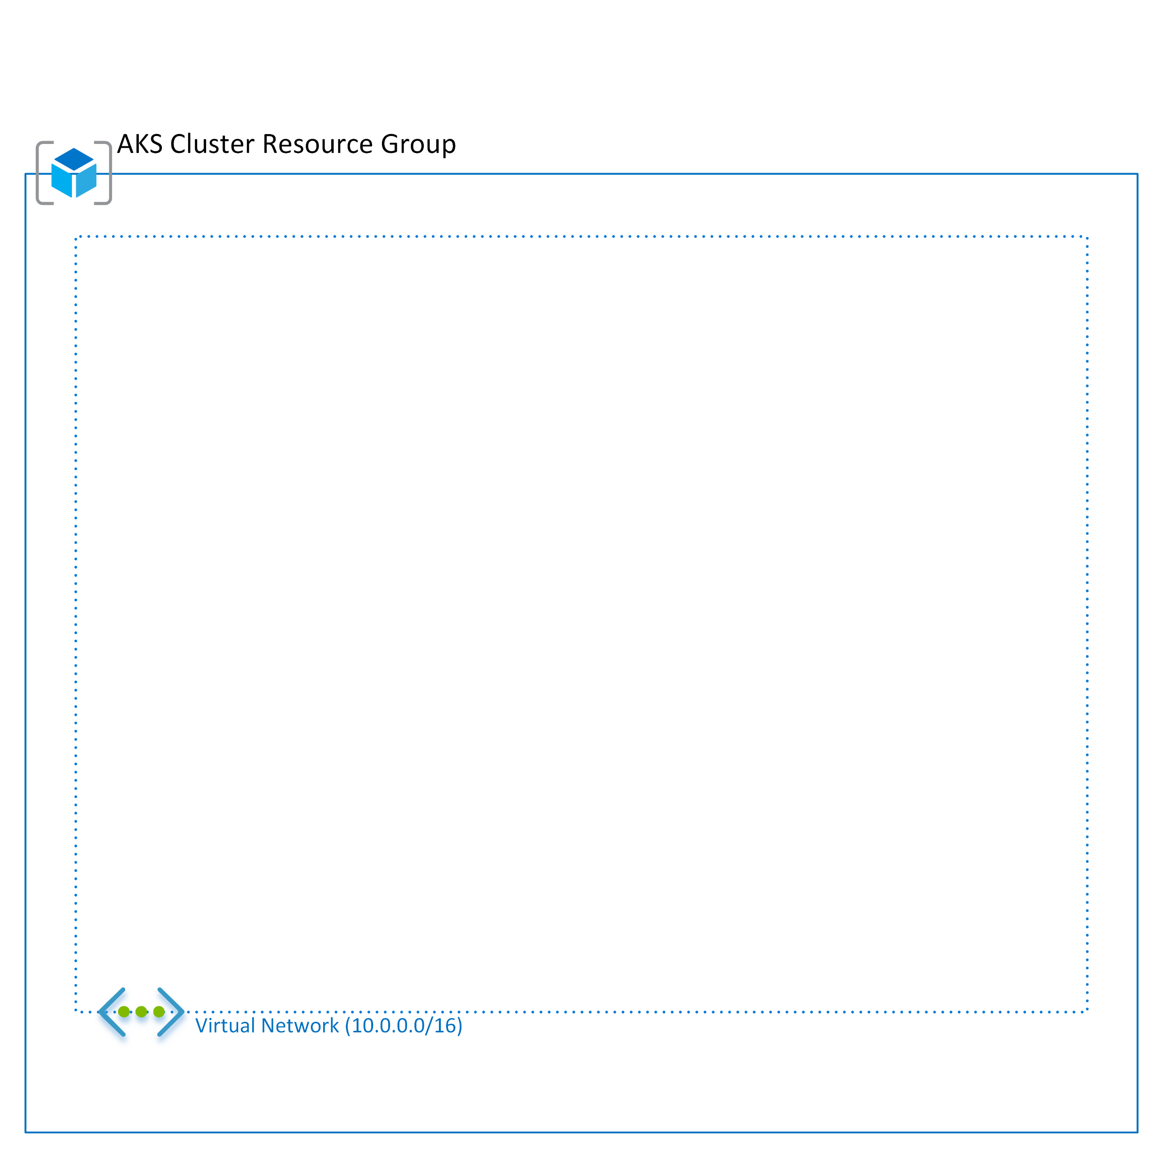
Virtual Network
Notes:
Azure Virtual Network enables many types of Azure resources, such as Azure Virtual Machines (VM), to securely communicate with each other, the internet, and on-premises networks.
A virtual network is scoped to a single region; however, multiple virtual networks from different regions can be connected together using Virtual Network Peering.
Titan-Atlas (AKS) lives in a completely isolated virtual network in the Azure public network.
It is not connected to the CMFG on-premise network.

Slide 37
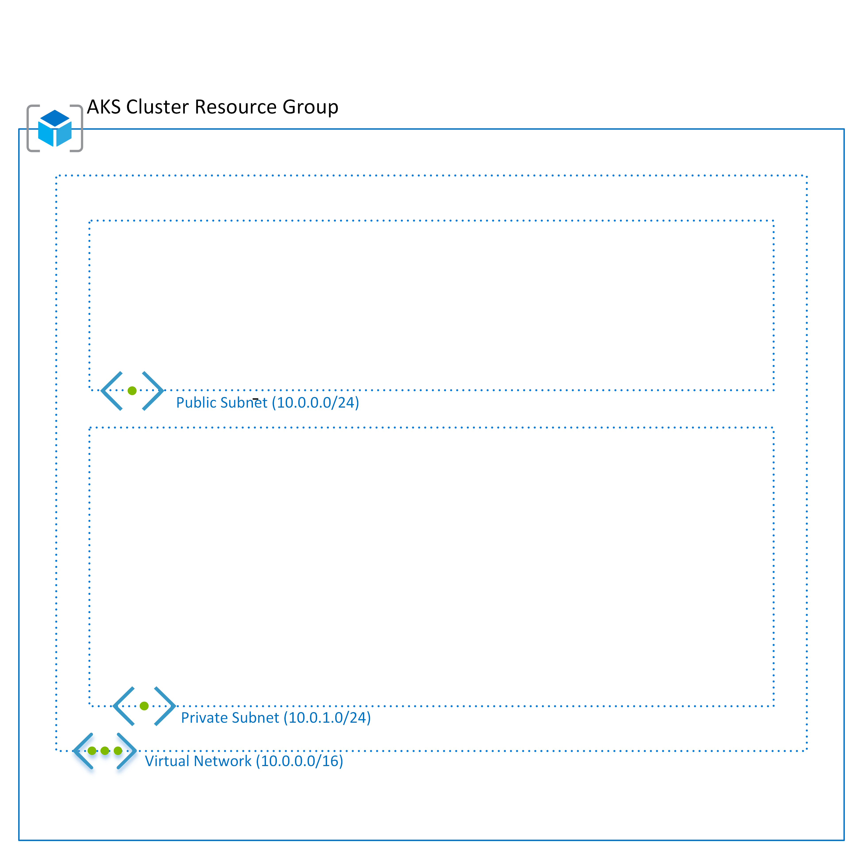
Private and Public Subnets
Notes:
Isolation and segmentation
You can implement multiple virtual networks within each Azure subscription and Azure region.
Each virtual network is isolated from other virtual networks. For each virtual network you can:
Specify a custom private IP address space using public and private (RFC 1918) addresses. Azure assigns resources in a virtual network a private IP address from the address space that you assign.
Segment the virtual network into one or more subnets and allocate a portion of the virtual network's address space to each subnet.
Use Azure-provided name resolution, or specify your own DNS server, for use by resources in a virtual network.

Slide 38
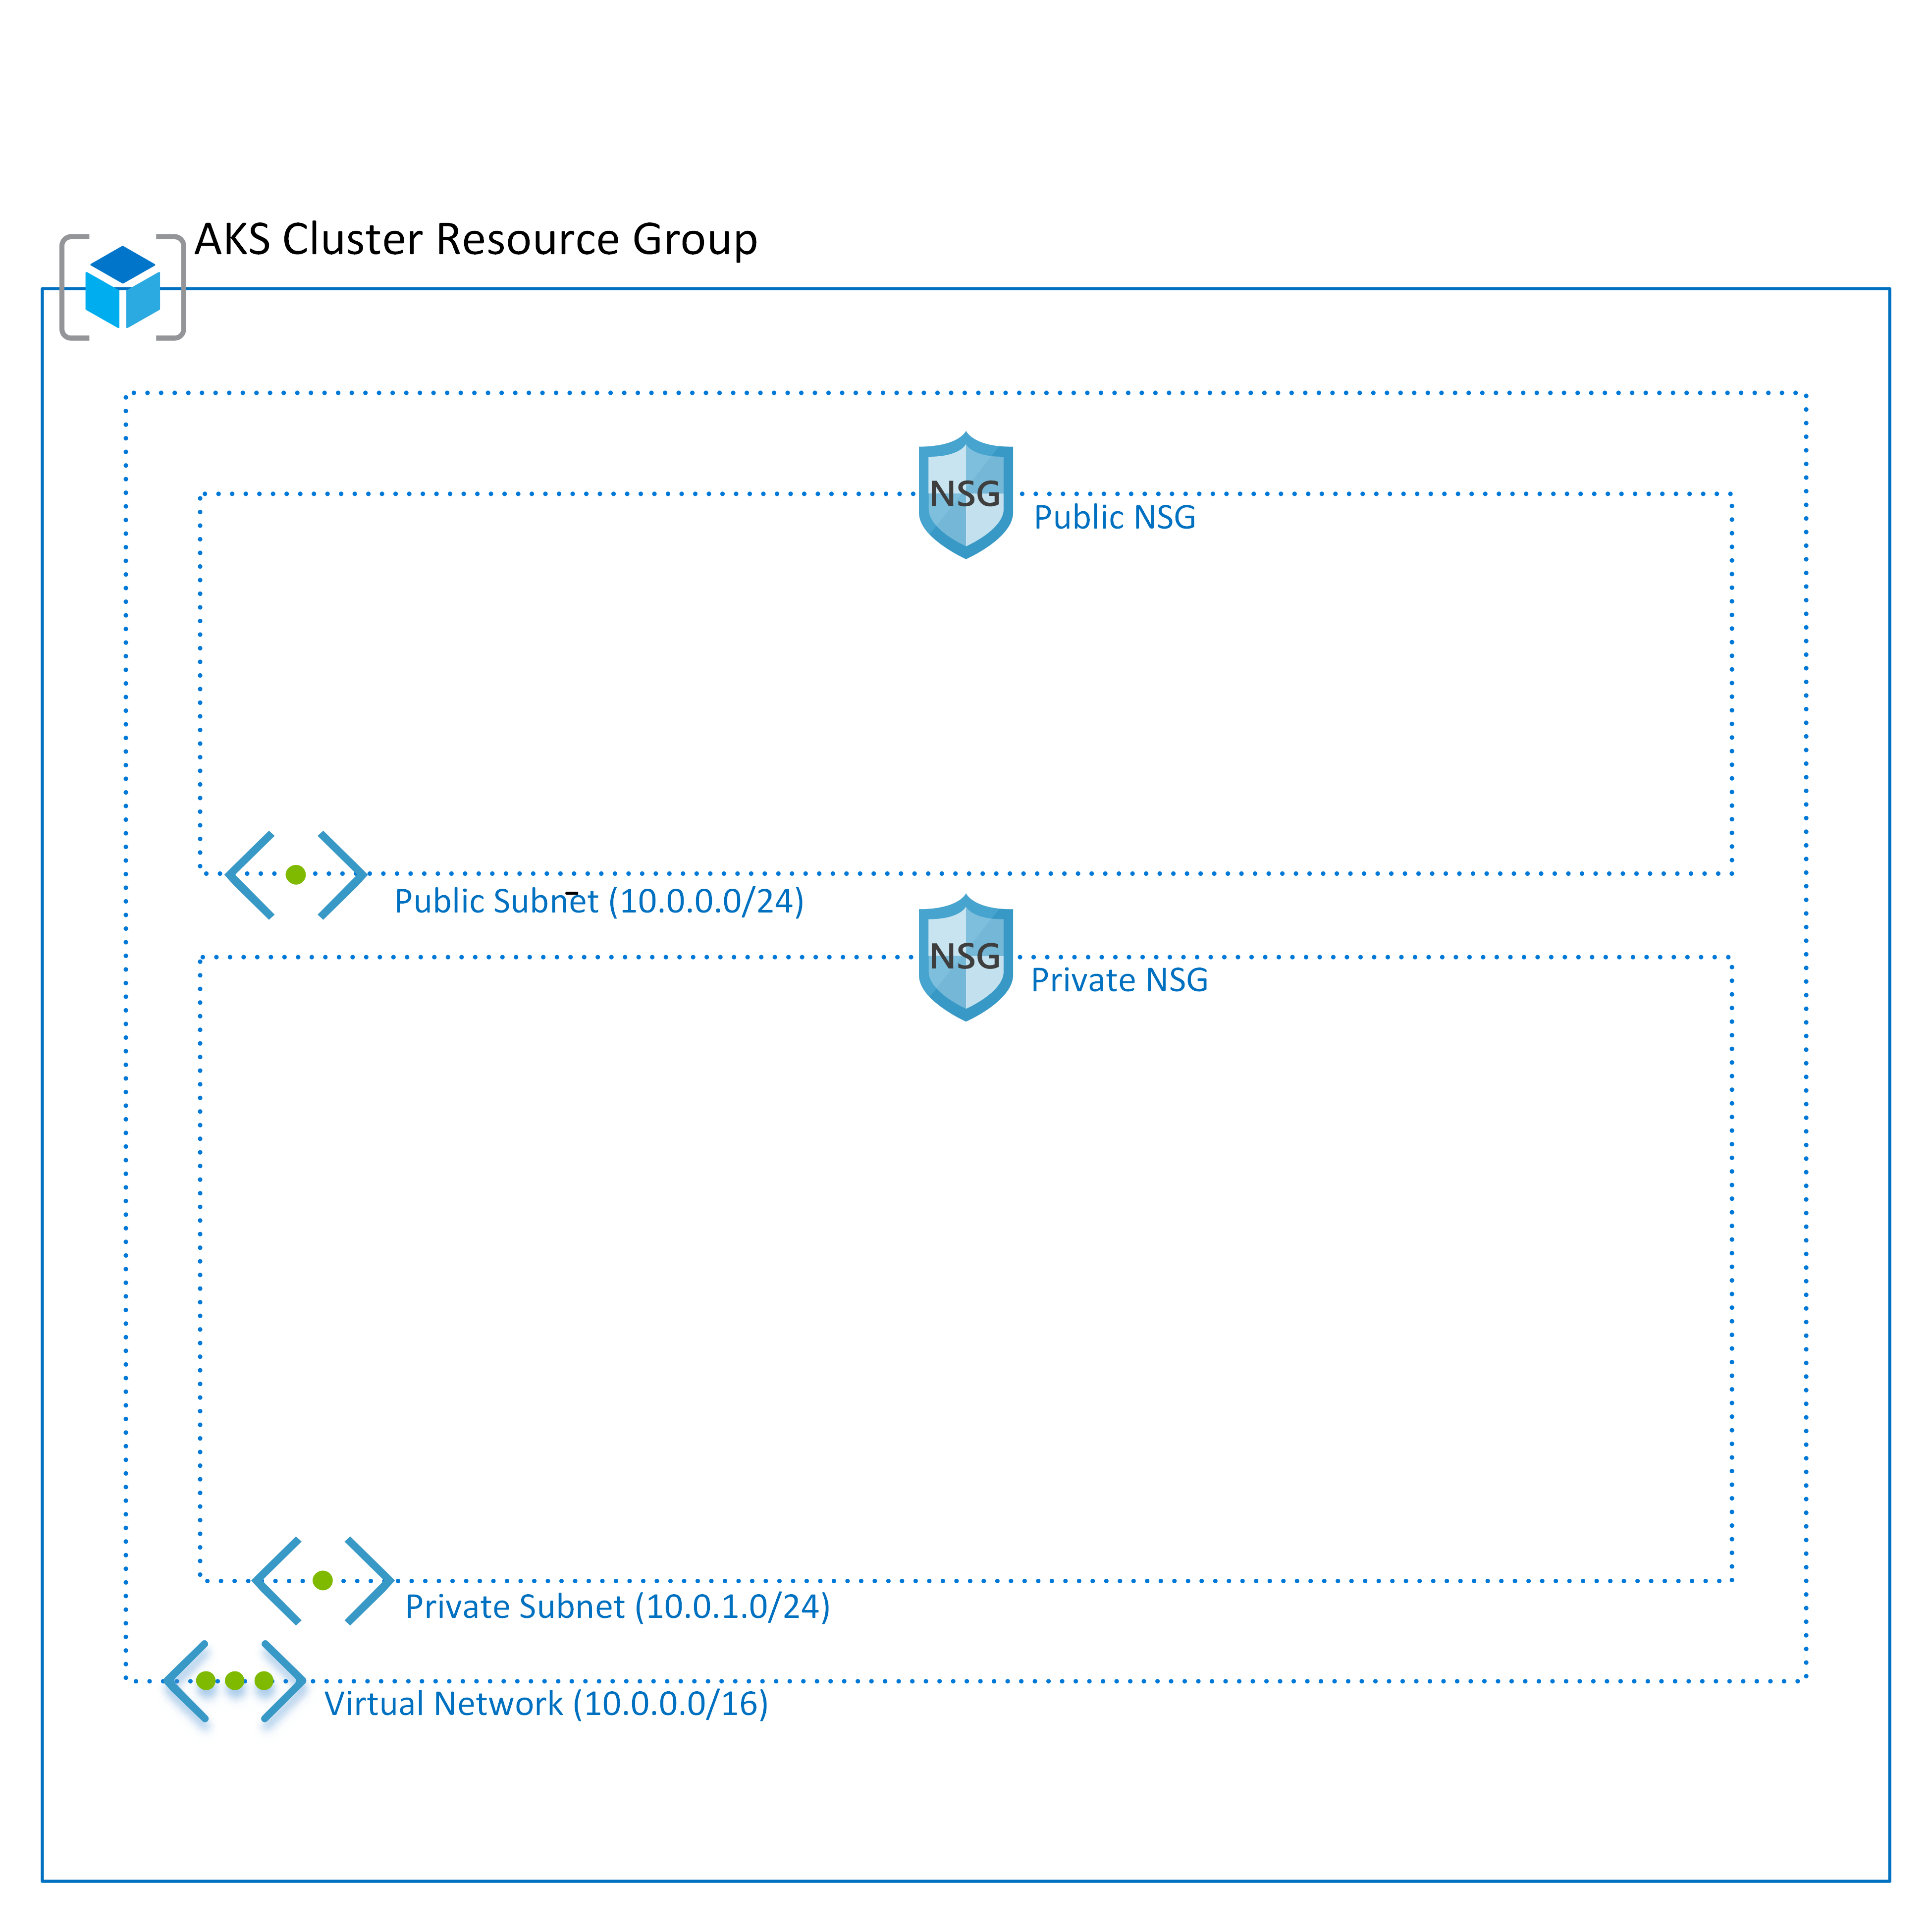
Private and Public Network Security Groups
Notes:
Filter network traffic
You can filter network traffic between subnets using either or both of the following options:
Security groups
Network security groups (NSG) and application security groups can contain multiple inbound and outbound security rules that enable you to filter traffic to and from resources by source and destination IP address, port, and protocol.
Network virtual appliances
The A network virtual appliance is a VM that performs a network function, such as a firewall, WAN optimization, or other network function.

Slide 39
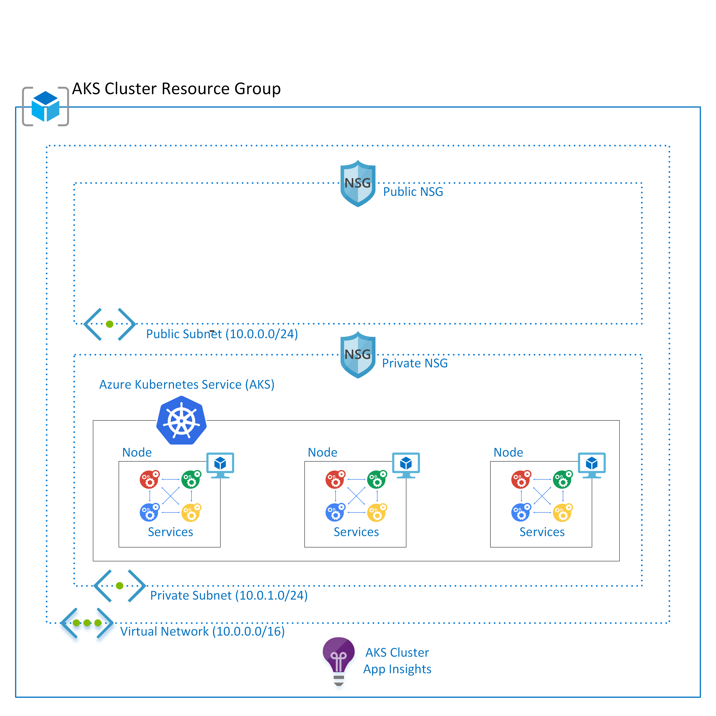
Azure Kubernetes Service (AKS)
Notes:
Azure Kubernetes Service (AKS)
Azure Kubernetes Service makes it simple to deploy a managed Kubernetes cluster in Azure. AKS reduces the complexity and operational overhead of managing Kubernetes by offloading much of that responsibility to Azure.
Application Insights
Application Insights is an extensible Application Performance Management (APM) service for web developers on multiple platforms.
Use it to monitor your live web application.
It automatically detects performance anomalies.
It includes powerful analytics tools to help you diagnose issues and to understand what users actually do with your app.
It's designed to help you continuously improve performance and usability.

Slide 40
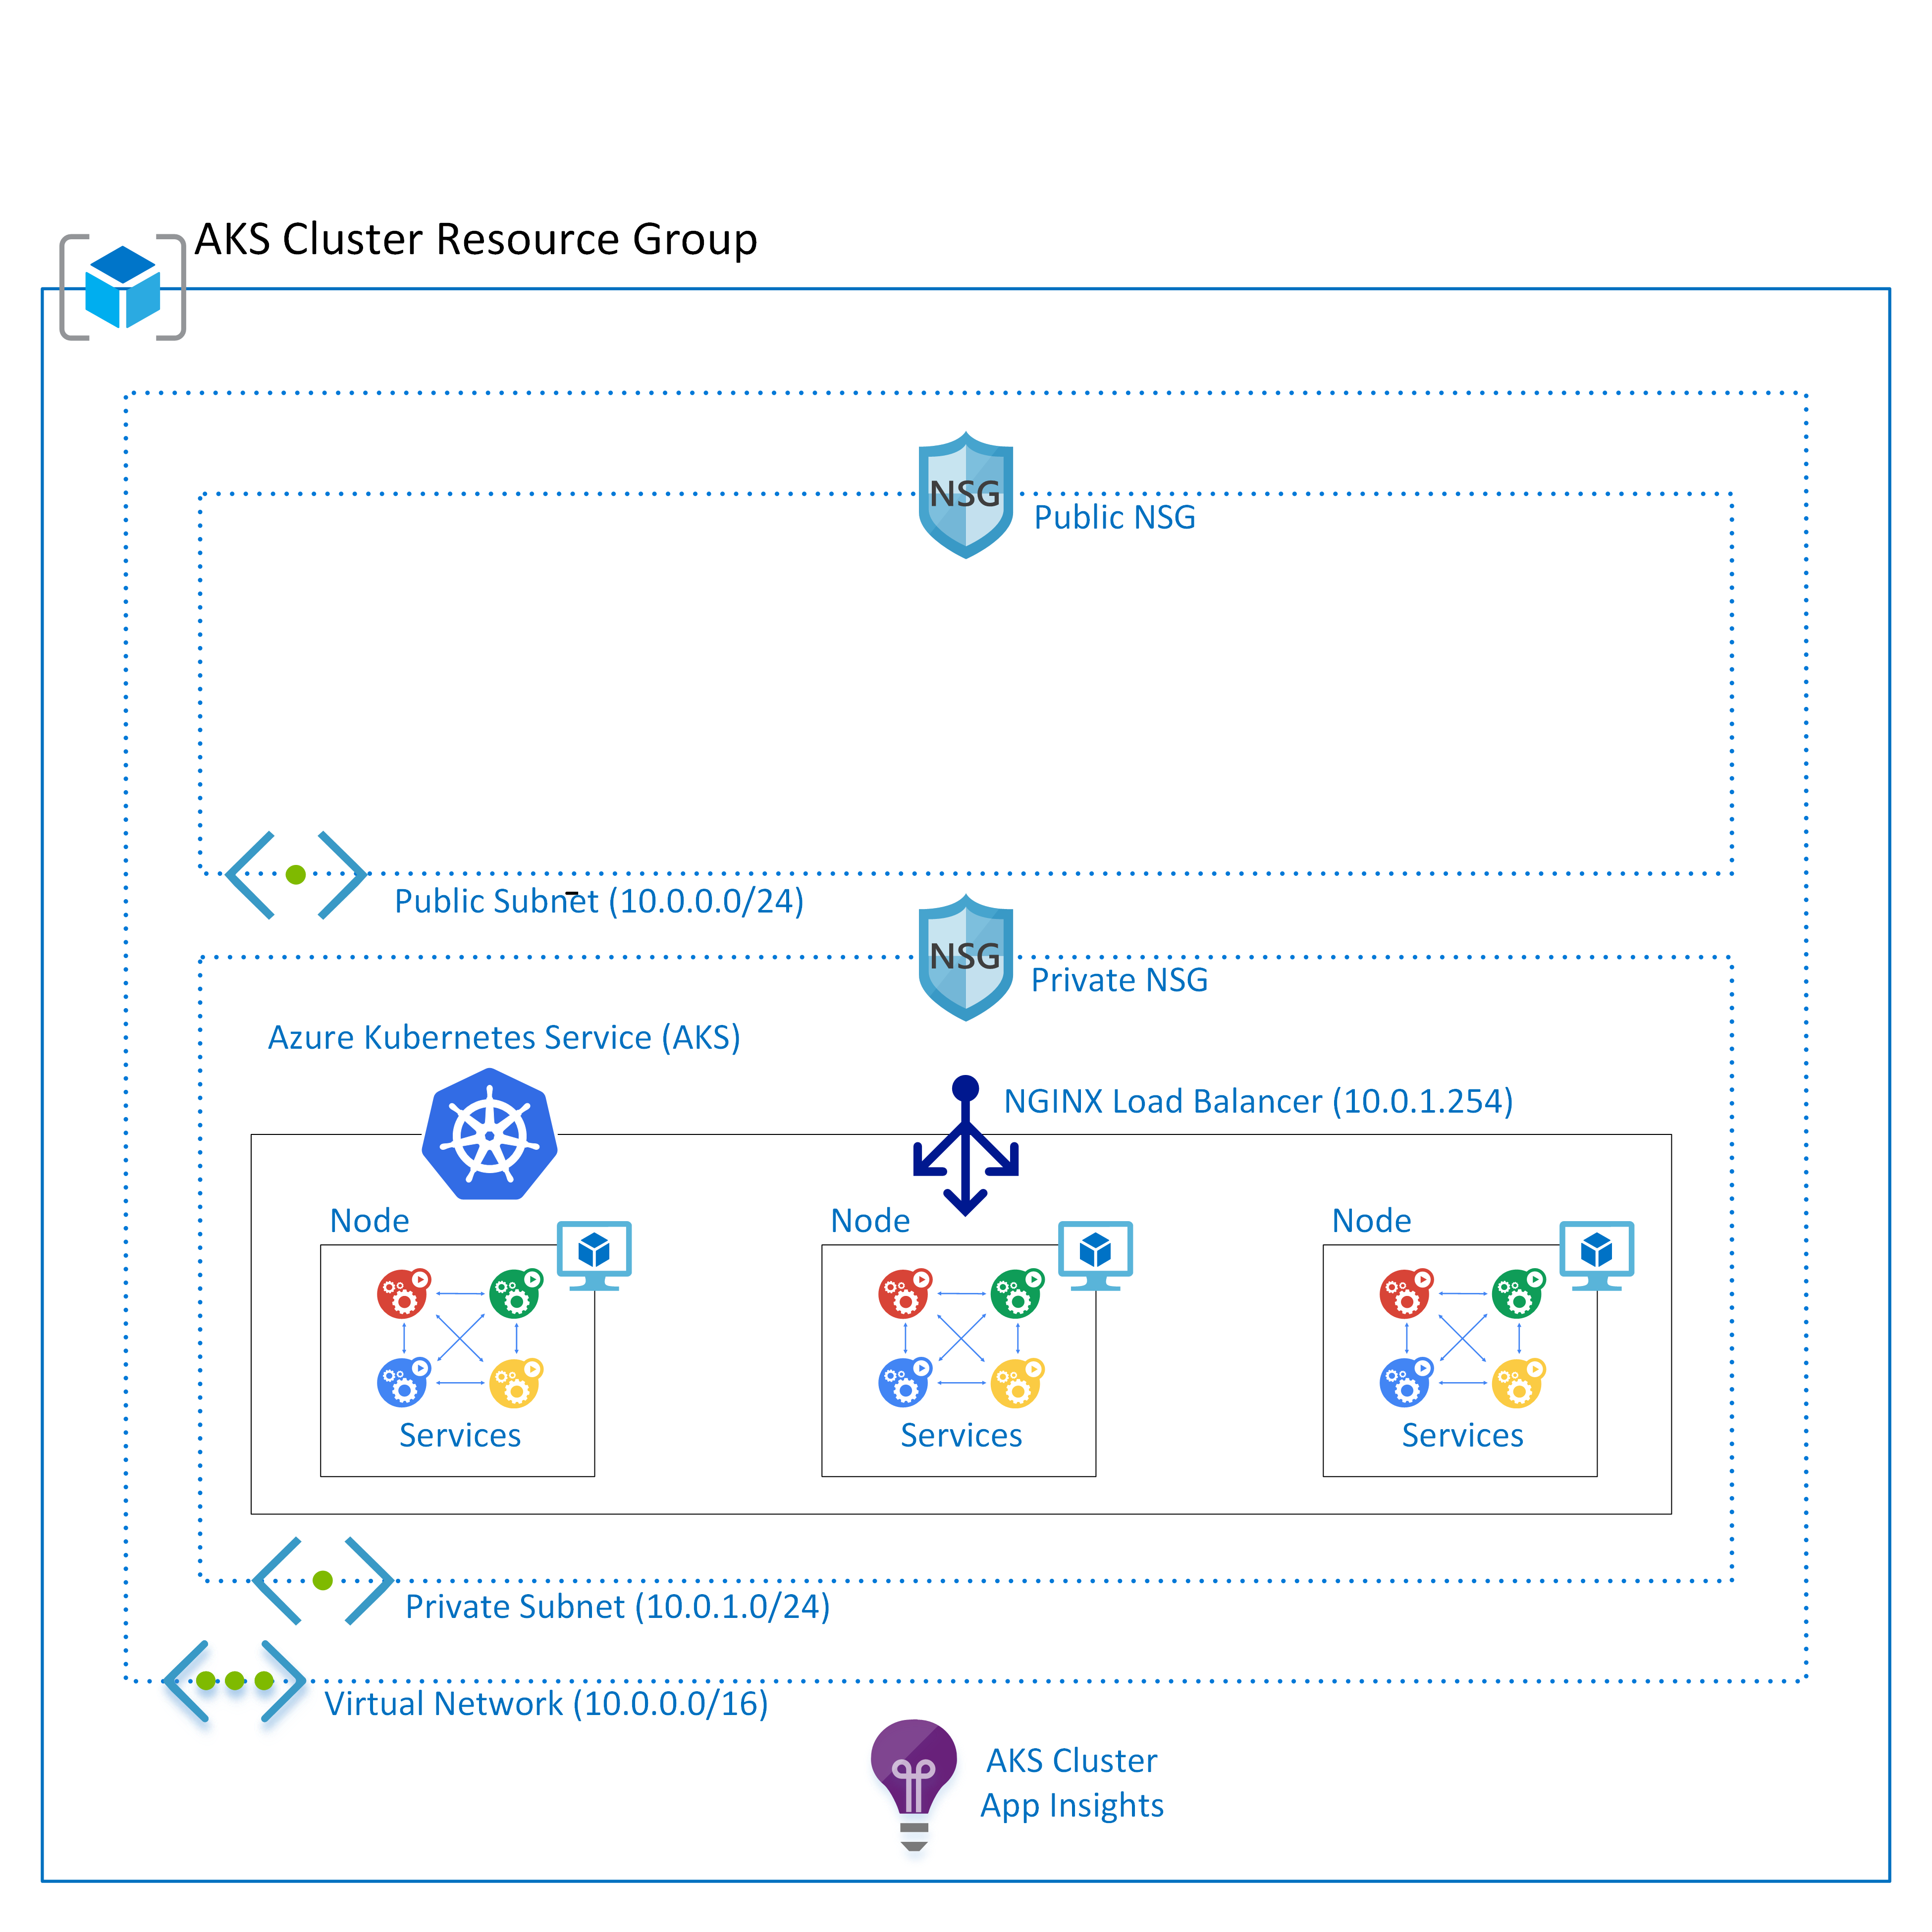
NGINX Ingress Controller, Load Balancer
Notes:
What is an Ingress Controller?
Configuring a webserver or load balancer is harder than it should be.
Most webserver configuration files are very similar.
There are some applications that have weird little quirks that tend to throw a wrench in things, but for the most part you can apply the same logic to them and achieve a desired result.
The Ingress resource embodies this idea, and an Ingress controller is meant to handle all the quirks associated with a specific "class" of Ingress.
An Ingress Controller is a daemon, deployed as a Kubernetes Pod, that watches the api server's ingresses endpoint for updates to the Ingress resource.
Its job is to satisfy requests for Ingresses.
NGINX Ingress Controller
The NGINX ingress resource defines rules, including the URI path, backing service name, and other information for the services running in the AKS cluster.
The ingress controller can automatically programs a frontend load balancer to enable Ingress configuration.
The ingress controller runs as a pod within the AKS cluster.

Slide 41
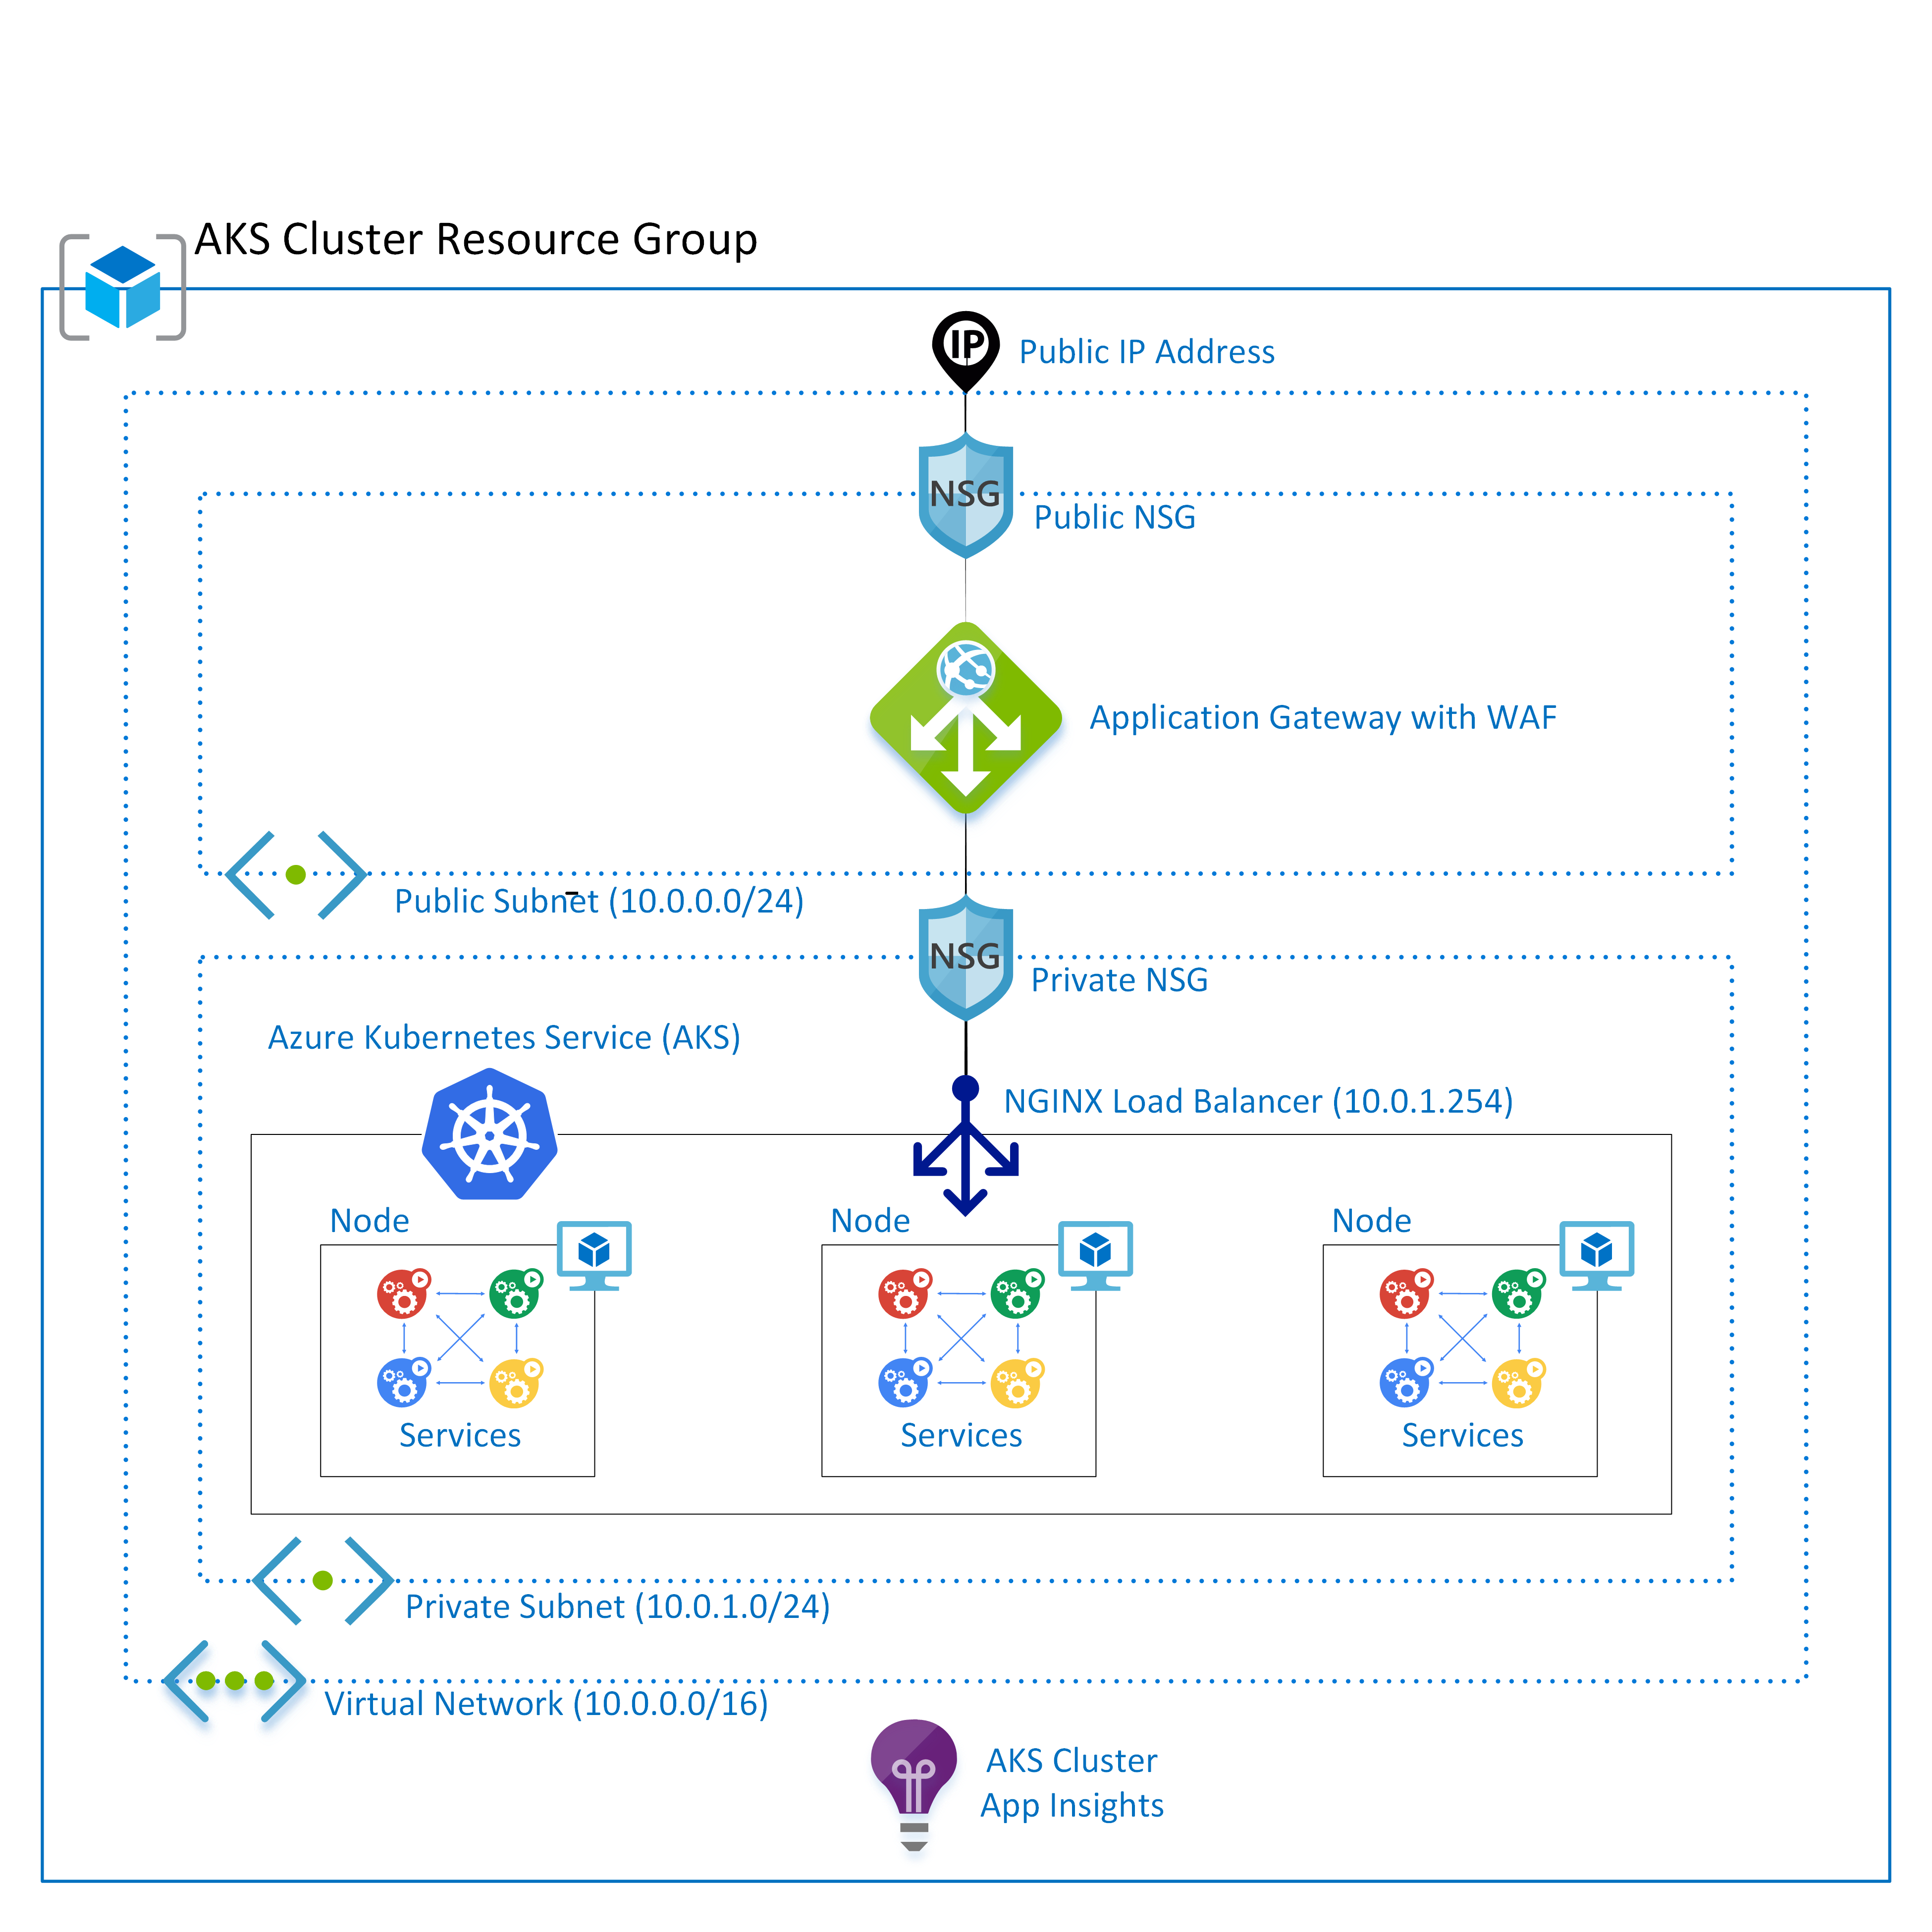
Azure Application Gateway with WAF, Public IP
Notes:
Azure Application Gateway
The Azure Application Gateway is a web traffic load balancer that manages and routes traffic to web resources in the private subnet.
Web Application Firewall
The Azure Application Gateway also include a Web Application Firewall (WAF)
A web application firewall (WAF) is an application firewall for HTTP applications.
It applies a set of rules to an HTTP conversation.
Generally, these rules cover common attacks such as cross-site scripting (XSS) and SQL injection.
While proxies generally protect clients, WAFs protect servers.
A WAF is deployed to protect a specific web application or set of web applications.
A WAF can be considered a reverse proxy.
Public IP Address
All traffic enters the virtual network is through an Azure Public IP address resource.
Public IP addresses allow Internet resources to communicate inbound to Azure resources.
Public IP addresses also enable Azure resources to communicate outbound to Internet and public-facing Azure services with an IP address assigned to the resource.

Slide 42
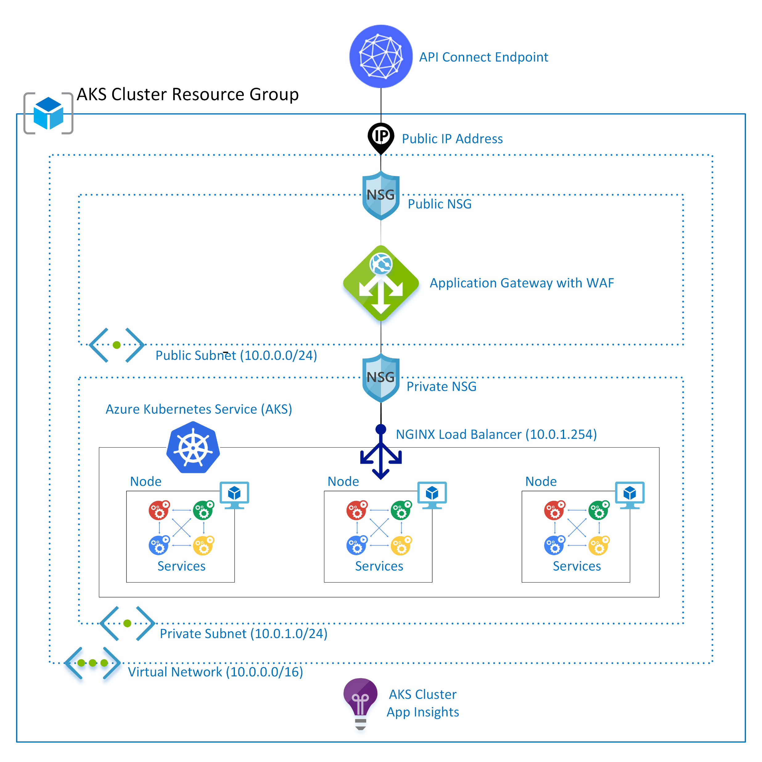
IBM API Connect Endpoint
Notes:
IBM API Connect
IBM API Connect is an integrated API management offering, with capabilities and tooling for all phases of the API lifecycle.
Key steps of the API lifecycle include create, secure, manage, socialize, and analyze.
IBM API Connect has two main focuses:
Providing best in class API Management tooling
Having a cloud native solution.
This allows users to create, manage, and secure applications that are deployed across a variety of on-premises and cloud environments.

Slide 43
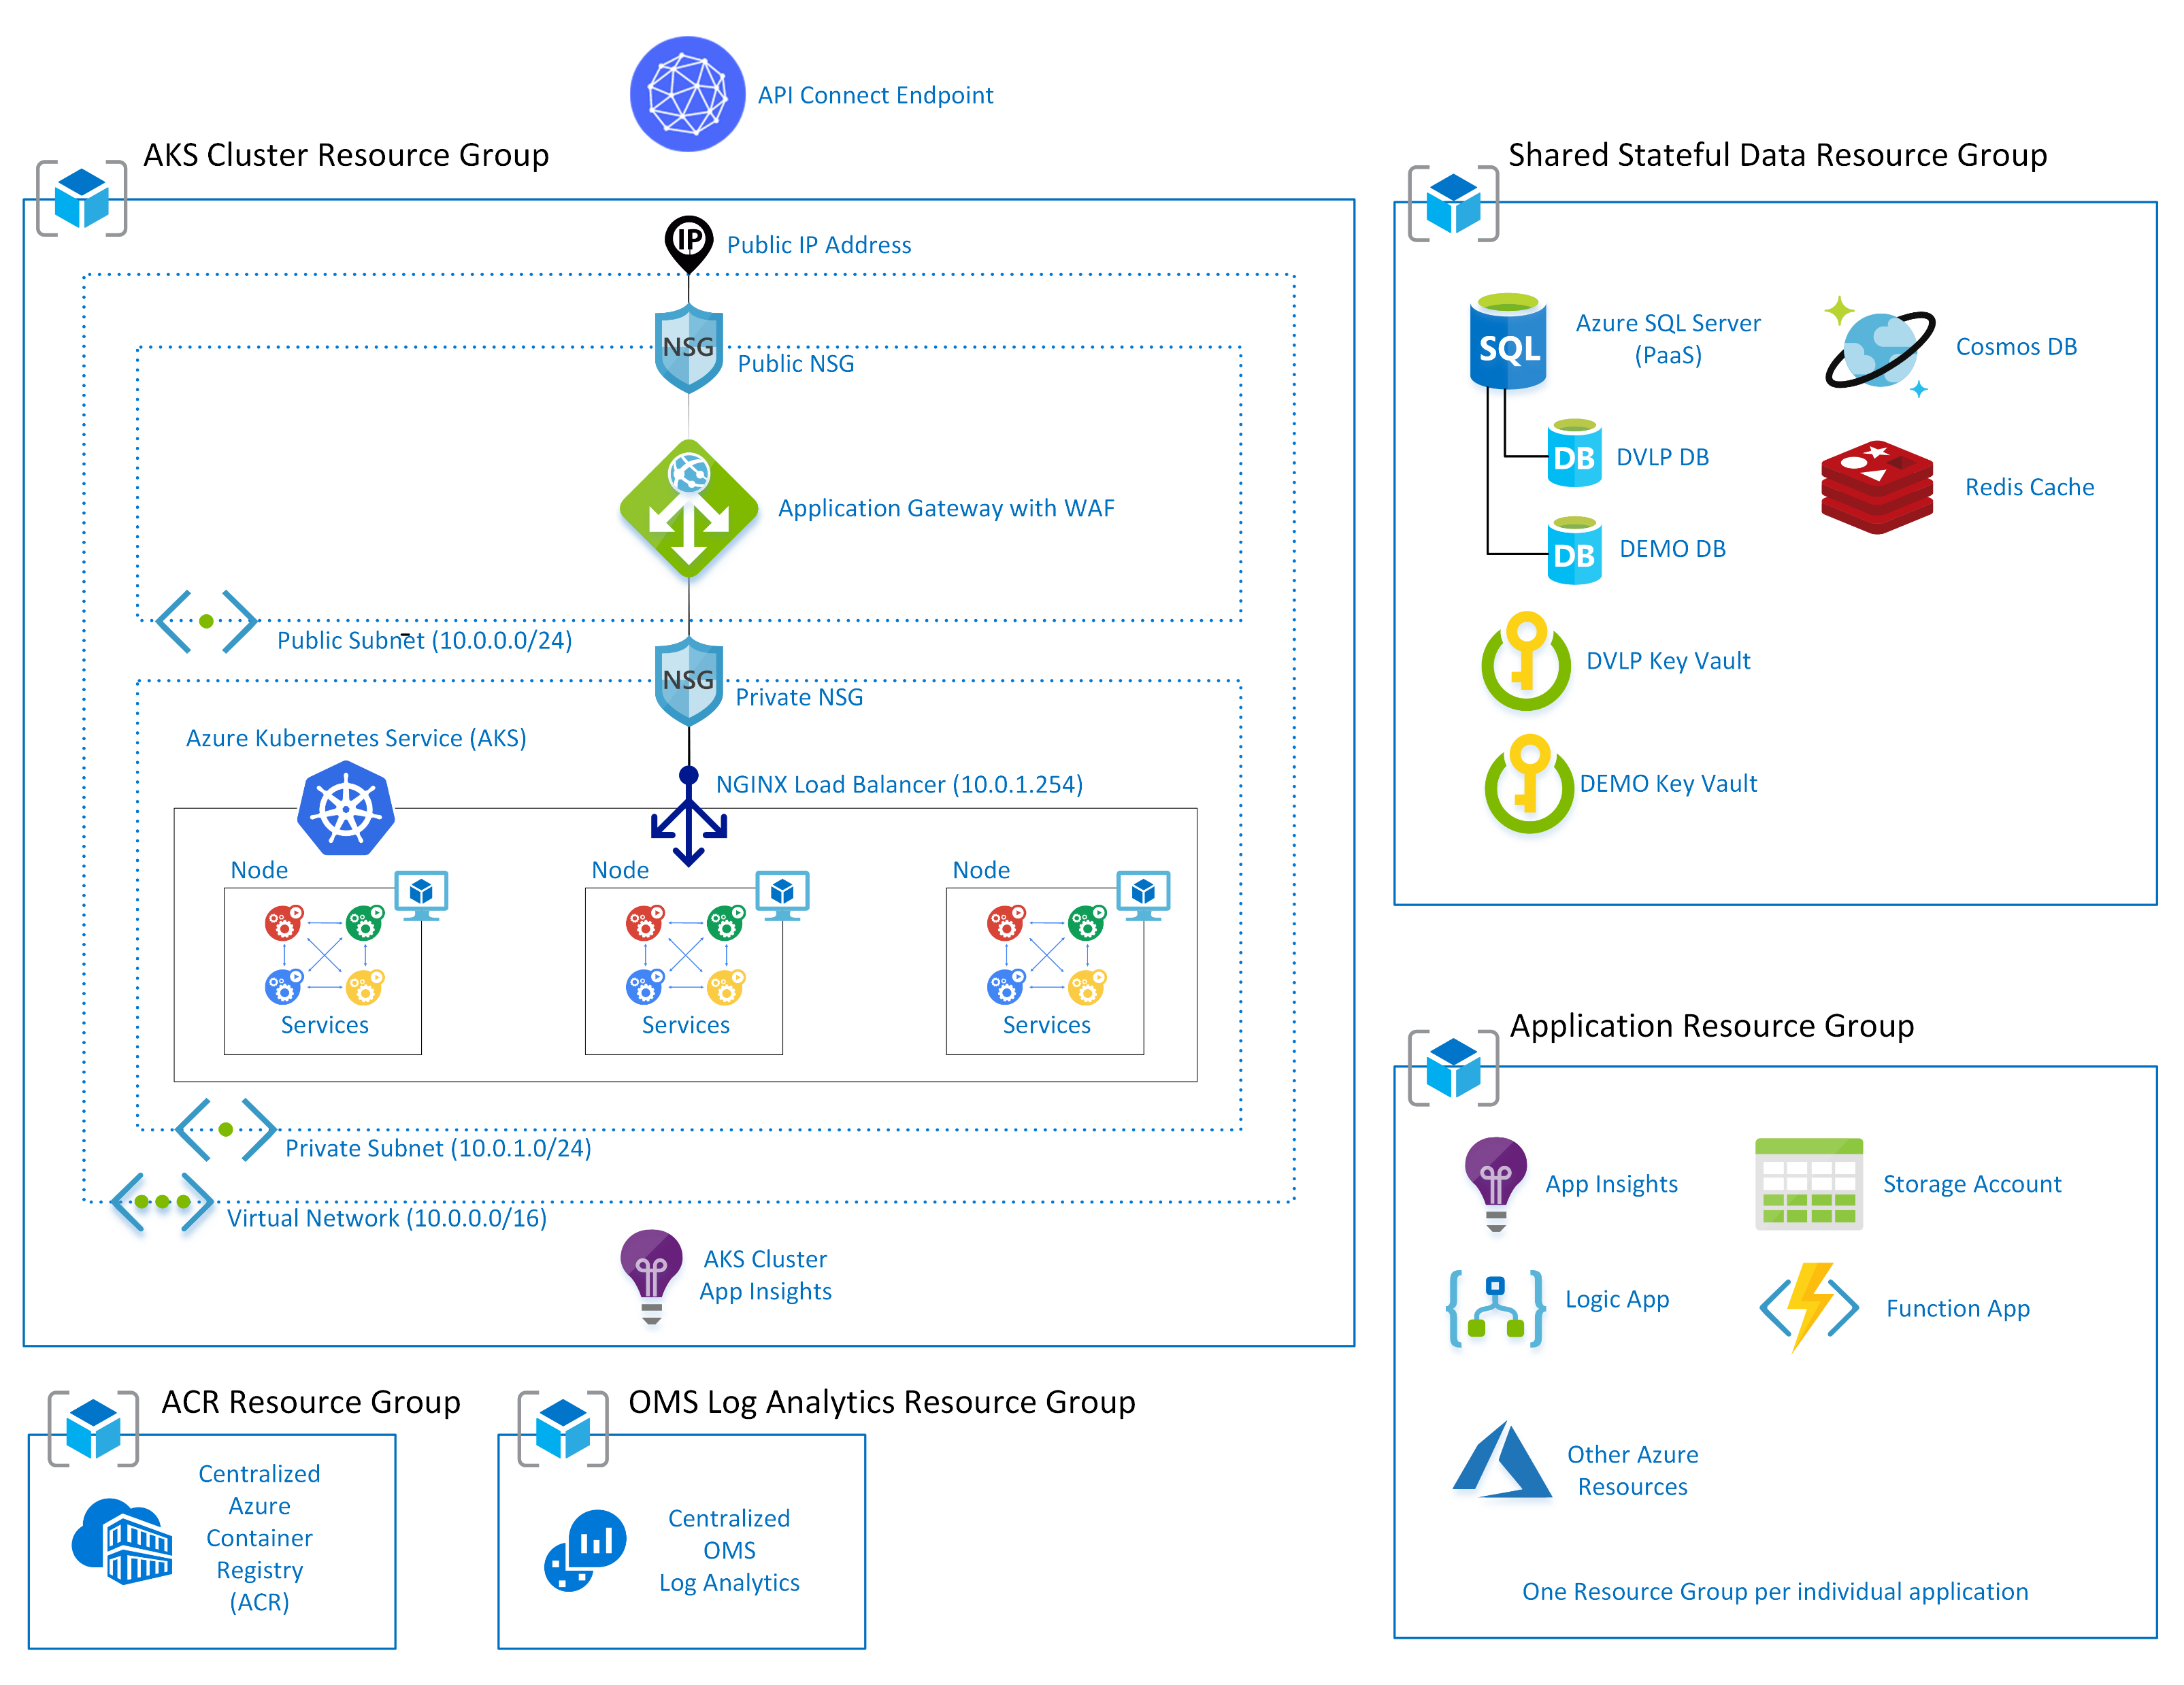
AKS With Service Integrations
Notes:
The Titan-Atlas-AKS product integrates with other Azure services, as needed.
Each subscription has its own instance of OMS Log Analytics.
Each IT Portfolio has its own NonProd and Prod Azure Container Registries.
Each IT Portfolio has its own Key Vault dedicated to storing Azure Release Manager secrets.
Each IT Portfolio has its own Key Vaults dedicated to storing shared AKS secrets.
Each Titan-Atlas-AKS instance has one or more SQL Server databases.

Slide 44
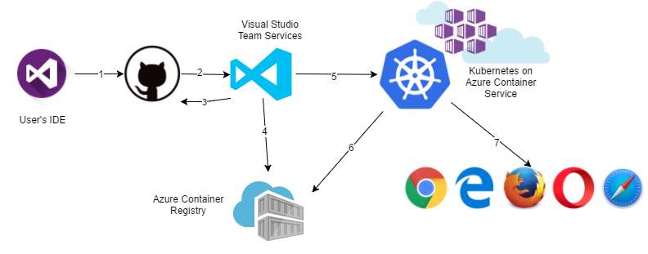
Azure DevOps Pipeline

Slide 45
How To Build And Deploy Apps To Azure Kubernetes Service Using Azure DevOps
Demos

Slide 46
How to Manage Access, Security, and Monitoring in AKS
For improved security and management, AKS lets you integrate with Azure Active Directory and use Kubernetes role-based access controls.
You can also monitor the health of your cluster and resources.
Azure Monitor for containers overview
Enable and review Kubernetes master node logs in Azure Kubernetes Service (AKS)

Slide 47
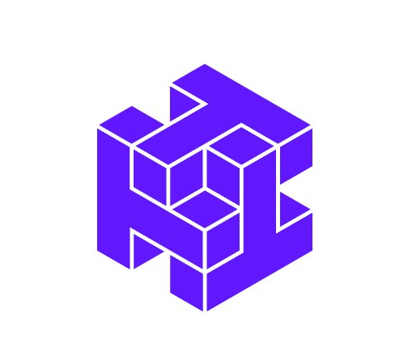
Twistlock
Centralized tool for decentralized workloads
Compliance and Vulnerability Detection & Management
Behavioral analysis – Which containers talk on which ports?
Runs as agent (daemonset) on Kubernetes cluster
Notes:
What Is Azure Kubernetes Service (AKS)?
Azure Kubernetes Service (AKS) makes it simple to deploy a managed Kubernetes cluster in Azure.
AKS reduces the complexity and operational overhead of managing Kubernetes by offloading much of that responsibility to Azure.
As a hosted Kubernetes service, Azure handles critical tasks like health monitoring and maintenance for you.
How Virtual Networks and Ingress Make AKS a Secure Environment
An AKS cluster can be deployed into an existing virtual network. In this configuration, every pod in the cluster is assigned an IP address in the virtual network, and can directly communicate with other pods in the cluster, and other nodes in the virtual network.
Pods can also connect to other services in a peered virtual network, and to on-premises networks over ExpressRoute or site-to-site (S2S) VPN connections.

Slide 48

TwistLock @ CMFG
Monitors images at runtime to ensure compliance and vulnerability thresholds are met
Scans images during CI, potentially even from local developer workstations (future)
Scans ACRs for status of existing images
Today - focused on Container use cases
Product also supports Functions
Product also provides WAF capabilities

Slide 49
What Else Should I Do To Secure My Cloud Applications?
Security concepts for applications and clusters in Azure Kubernetes Service (AKS)
Cluster operator and developer best practices to build and manage applications on Azure Kubernetes Service (AKS)

Slide 50
OK, So How Do I Get Started With AKS?
Tutorial: Deploy ASP.NET Core apps to Azure Kubernetes Service with Azure DevOps Projects
Quickstart: Deploy an Azure Kubernetes Service (AKS) cluster using the Azure portal
Quickstart: Deploy an Azure Kubernetes Service (AKS) cluster using the Azure CLI
Microsoft Azure Developer: Deploying and Managing Containers
Azure CLI: Getting Started
And then practice, practice, practice.

Slide 51
Contact Information
Email: dmoon396@hotmail.com
Blog: https://dennismoon.com/
LinkedIn: https://www.linkedin.com/in/dennis-moon-b469b93/
GitHub: https://github.com/comfycoder
Twitter: https://twitter.com/comfycoder
Twitter Handle: @comfycoder

Slide 52
Questions?

